Slide 1
Mathematics for AI
Adams Wai Kin Kong
School of Computer Science and Engineering
Nanyang Technological University, Singapore
adamskong@ntu.edu.sg

Slide 2
The Matrix Calculus You Need For Deep Leaning, Terence Parr and Jeremy Howard, July 2018 https://arxiv.org/pdf/1802.01528.pdf
Matrix Differentiation, Randal J Barnes,
https://atmos.washington.edu/~dennis/MatrixCalculus.pdf

Slide 3
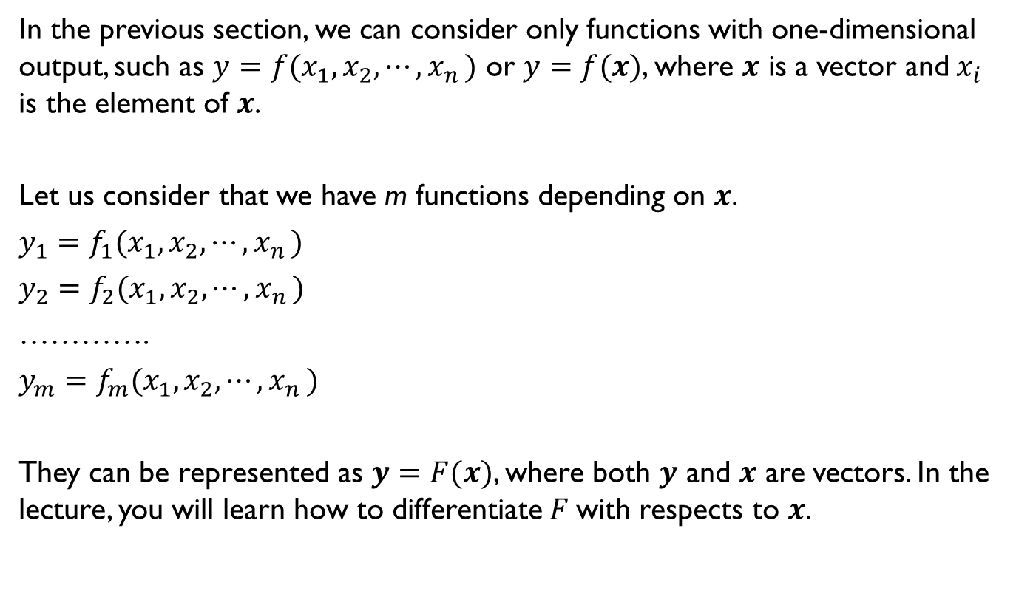
Matrix Calculus
In the previous section, we can consider only functions with one-dimensional output, such as $y=f(x_{1},x_{2},⋯{,x}_{n})$ or $y=f(x)$, where $x$ is a vector and$x_{i}$ is the element of $x$.
Let us consider that we have m functions depending on $x$.
$y_{1}=f_{1}(x_{1},x_{2},⋯{,x}_{n})$
$y_{2}=f_{2}(x_{1},x_{2},⋯{,x}_{n})$
………….
$y_{m}=f_{m}(x_{1},x_{2},⋯{,x}_{n})$
They can be represented as $y=F(x)$, where both $y$ and $x$ are vectors. In the lecture, you will learn how to differentiate $F$with respects to $x$.

Slide 4
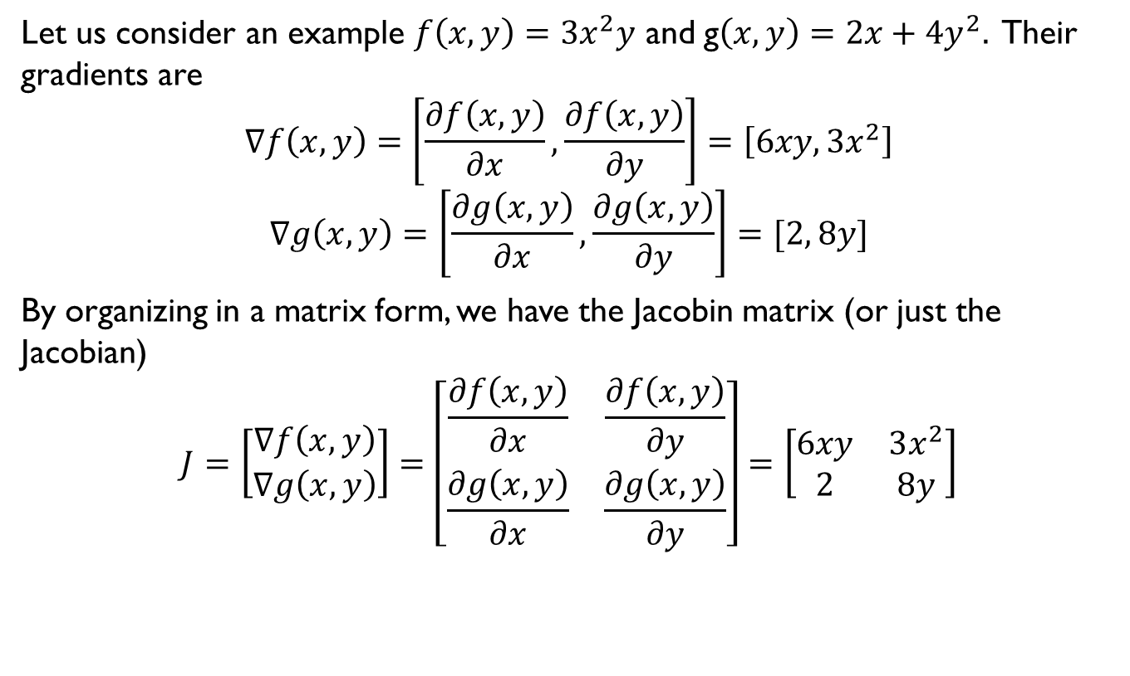
Jacobian
Let us consider an example $f\left(x,y\right)=3x^{2}y$ and g$\left(x,y\right)=2x+4y^{2}.$ Their gradients are
$$∇f\left(x,y\right)=\left[\frac{∂f\left(x,y\right)}{∂x},\frac{∂f\left(x,y\right)}{∂y}\right]=\left[6xy, 3x^{2}\right]$$
$$∇g\left(x,y\right)=\left[\frac{∂g\left(x,y\right)}{∂x},\frac{∂g\left(x,y\right)}{∂y}\right]=[2, 8y]$$
By organizing in a matrix form, we have the Jacobin matrix (or just the Jacobian)
$$J=\left[\begin{matrix}∇f\left(x,y\right) \\ ∇g\left(x,y\right)\end{matrix}\right]=\left[\begin{matrix}\frac{∂f\left(x,y\right)}{∂x} & \frac{∂f\left(x,y\right)}{∂y} \\ \frac{∂g\left(x,y\right)}{∂x} & \frac{∂g\left(x,y\right)}{∂y}\end{matrix}\right]=\left[\begin{matrix}6xy & 3x^{2} \\ 2 & 8y\end{matrix}\right]$$

Slide 5
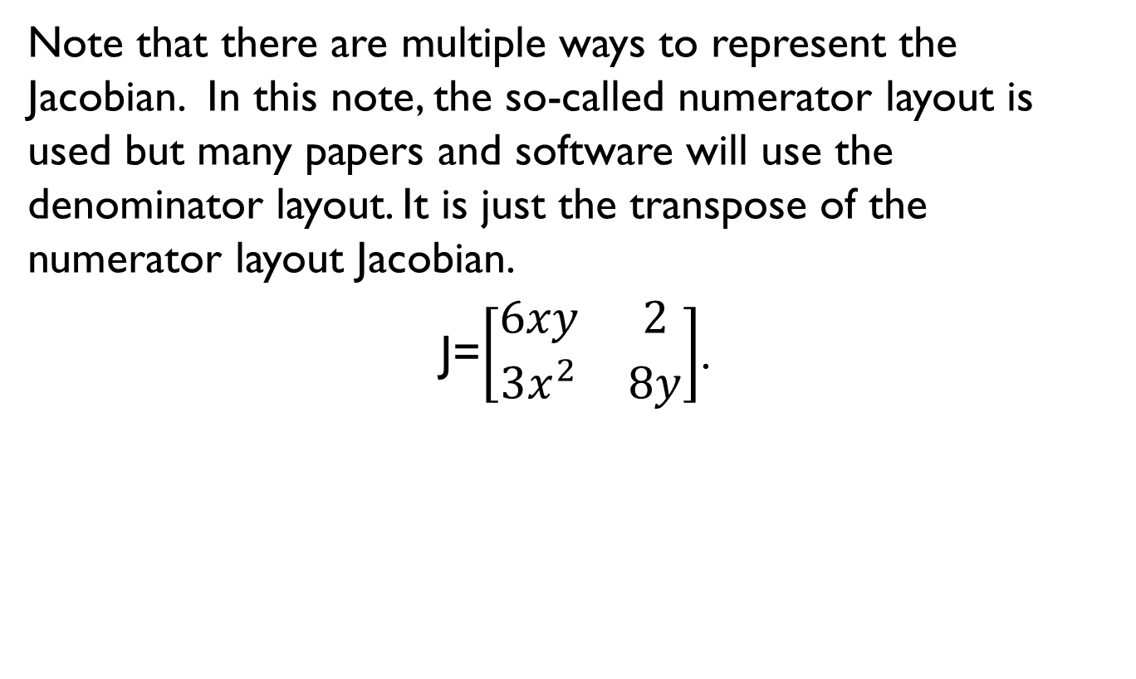
Jacobian
Note that there are multiple ways to represent the Jacobian. In this note, the so-called numerator layout is used but many papers and software will use the denominator layout. It is just the transpose of the numerator layout Jacobian.
J=$\left[\begin{matrix}6xy & 2 \\ 3x^{2} & 8y\end{matrix}\right]$.

Slide 6
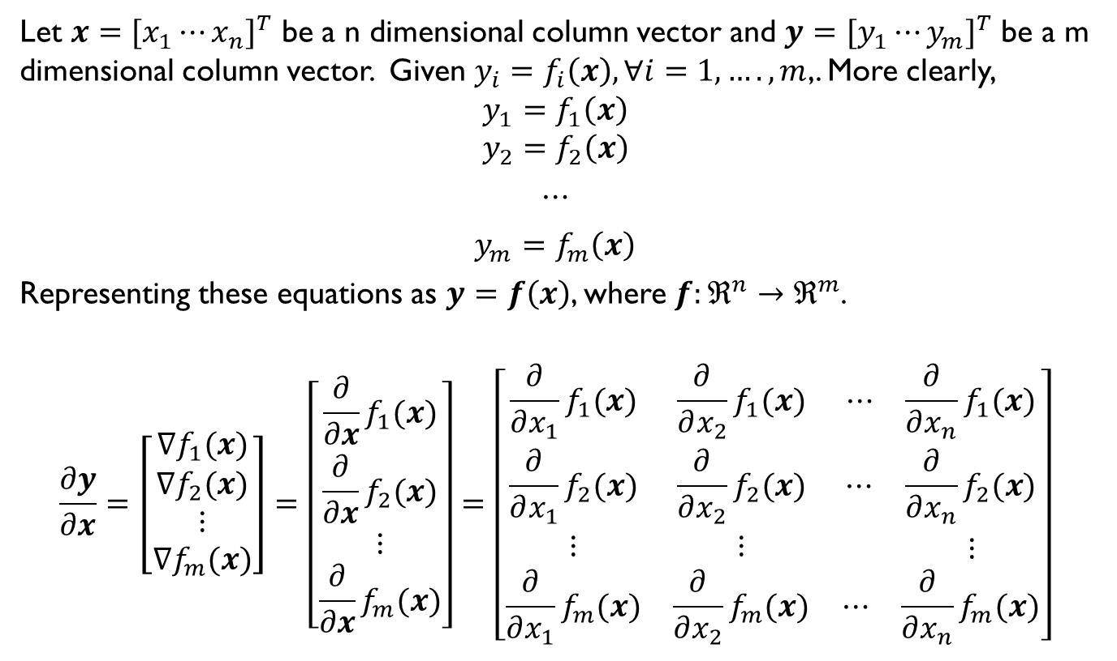
Jacobian
Let $x={[x_{1}⋯x_{n}]}^{T}$ be a n dimensional column vector and $y={[y_{1}⋯y_{m}]}^{T}$ be a m dimensional column vector. Given $y_{i}=f_{i}\left(x\right), ∀i=1,…., m$,. More clearly,
$$y_{1}=f_{1}\left(x\right)$$
$$y_{2}=f_{2}\left(x\right)$$
$⋯$
$y_{m}=f_{m}\left(x\right)$
Representing these equations as $y=f\left(x\right)$, where $f:ℜ^{n}→ℜ^{m}$.
$$\frac{∂y}{∂x}=\left[\begin{matrix}∇f_{1}(x) \\ \begin{matrix}∇f_{2}(x) \\ \begin{matrix}⋮ \\ ∇f_{m}(x)\end{matrix}\end{matrix}\end{matrix}\right]=\left[\begin{matrix}\frac{∂}{∂x}f_{1}(x) \\ \begin{matrix}\frac{∂}{∂x}f_{2}(x) \\ \begin{matrix}⋮ \\ \frac{∂}{∂x}f_{m}(x)\end{matrix}\end{matrix}\end{matrix}\right]=\left[\begin{matrix}\begin{matrix}\frac{∂}{∂x_{1}}f_{1}(x) \\ \frac{∂}{∂x_{1}}f_{2}(x)\end{matrix} & \begin{matrix}\frac{∂}{∂x_{2}}f_{1}(x) \\ \frac{∂}{∂x_{2}}f_{2}(x)\end{matrix} & \begin{matrix}\begin{matrix}⋯ & \frac{∂}{∂x_{n}}f_{1}(x)\end{matrix} \\ \begin{matrix}⋯ & \frac{∂}{∂x_{n}}f_{2}(x)\end{matrix}\end{matrix} \\ ⋮ & ⋮ & \begin{matrix} & ⋮\end{matrix} \\ \frac{∂}{∂x_{1}}f_{m}(x) & \frac{∂}{∂x_{2}}f_{m}(x) & \begin{matrix}⋯ & \frac{∂}{∂x_{n}}f_{m}(x)\end{matrix}\end{matrix}\right]$$

Slide 7

Jacobian
Note that each $\frac{∂}{∂x}f_{i}\left(x\right)$ is a row n-vector and n is the length of the vector. The Jacobian is a $m×n$ matrix (row $×$ column).

Slide 8
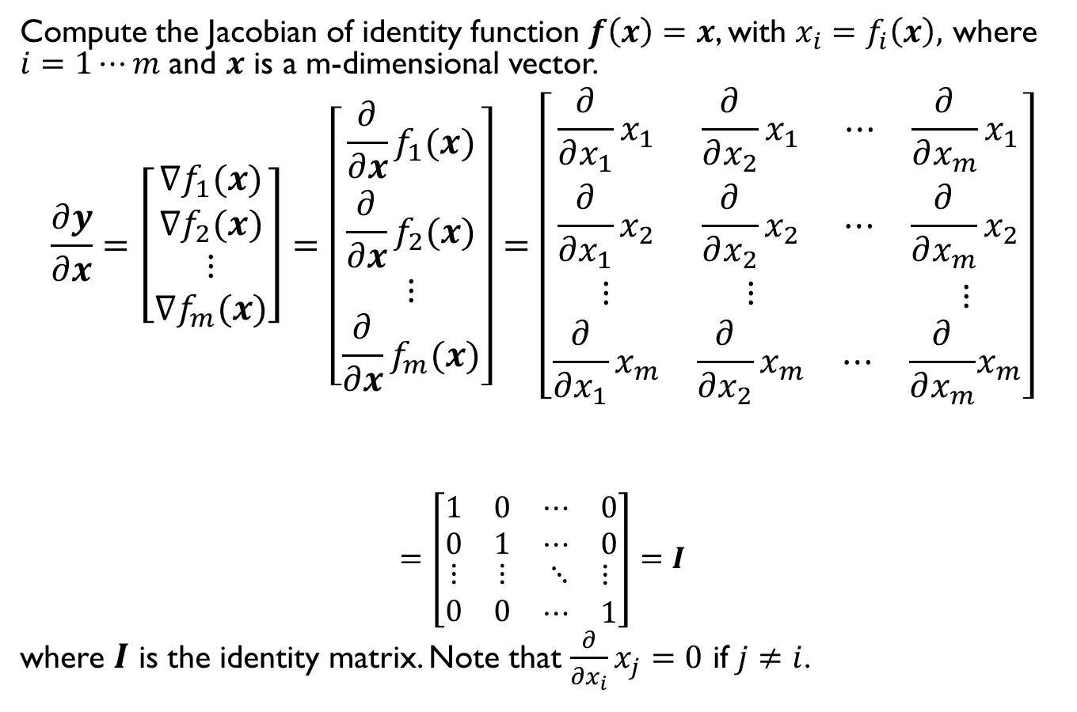
Example
Compute the Jacobian of identity function $f\left(x\right)=x$, with $x_{i}=f_{i}\left(x\right),$ where $i=1⋯m$ and $x$ is a m-dimensional vector.
$$\frac{∂y}{∂x}=\left[\begin{matrix}∇f_{1}(x) \\ \begin{matrix}∇f_{2}(x) \\ \begin{matrix}⋮ \\ ∇f_{m}(x)\end{matrix}\end{matrix}\end{matrix}\right]=\left[\begin{matrix}\frac{∂}{∂x}f_{1}(x) \\ \begin{matrix}\frac{∂}{∂x}f_{2}(x) \\ \begin{matrix}⋮ \\ \frac{∂}{∂x}f_{m}(x)\end{matrix}\end{matrix}\end{matrix}\right]=\left[\begin{matrix}\begin{matrix}\frac{∂}{∂x_{1}}x_{1} \\ \frac{∂}{∂x_{1}}x_{2}\end{matrix} & \begin{matrix}\frac{∂}{∂x_{2}}x_{1} \\ \frac{∂}{∂x_{2}}x_{2}\end{matrix} & \begin{matrix}\begin{matrix}⋯ & \frac{∂}{∂x_{m}}x_{1}\end{matrix} \\ \begin{matrix}⋯ & \frac{∂}{∂x_{m}}x_{2}\end{matrix}\end{matrix} \\ ⋮ & ⋮ & \begin{matrix} & ⋮\end{matrix} \\ \frac{∂}{∂x_{1}}x_{m} & \frac{∂}{∂x_{2}}x_{m} & \begin{matrix}⋯ & \frac{∂}{∂x_{m}}\end{matrix}x_{m}\end{matrix}\right]$$
$$=\left[\begin{matrix}\begin{matrix}1 \\ 0\end{matrix} & \begin{matrix}0 \\ 1\end{matrix} & \begin{matrix}\begin{matrix}⋯ & 0\end{matrix} \\ \begin{matrix}⋯ & 0\end{matrix}\end{matrix} \\ ⋮ & ⋮ & \begin{matrix}⋱ & ⋮\end{matrix} \\ 0 & 0 & \begin{matrix}⋯ & 1\end{matrix}\end{matrix}\right]=I$$
where $I$ is the identity matrix. Note that $\frac{∂}{∂x_{i}}x_{j}=0$ if $j≠i$.

Slide 9
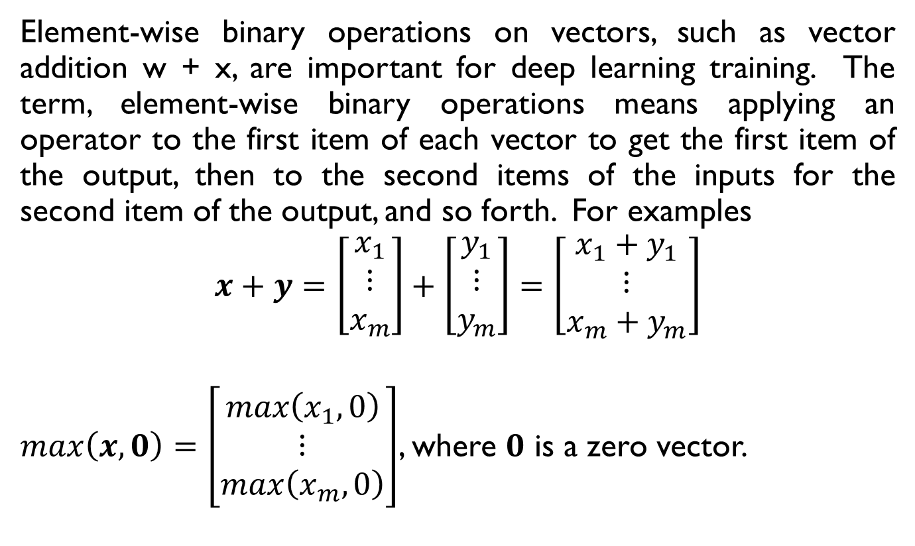
Derivatives of vector element-wise binary operators
Element-wise binary operations on vectors, such as vector addition w + x, are important for deep learning training. The term, element-wise binary operations means applying an operator to the first item of each vector to get the first item of the output, then to the second items of the inputs for the second item of the output, and so forth. For examples
$$x+y=\left[\begin{matrix}x_{1} \\ ⋮ \\ x_{m}\end{matrix}\right]+\left[\begin{matrix}y_{1} \\ ⋮ \\ y_{m}\end{matrix}\right]=\left[\begin{matrix}x_{1}+y_{1} \\ ⋮ \\ {x_{m}+y}_{m}\end{matrix}\right]$$
$max\left(x,0\right)=\left[\begin{matrix}max\left(x_{1},0\right) \\ ⋮ \\ max\left(x_{m},0\right)\end{matrix}\right]$, where $0$ is a zero vector.

Slide 10
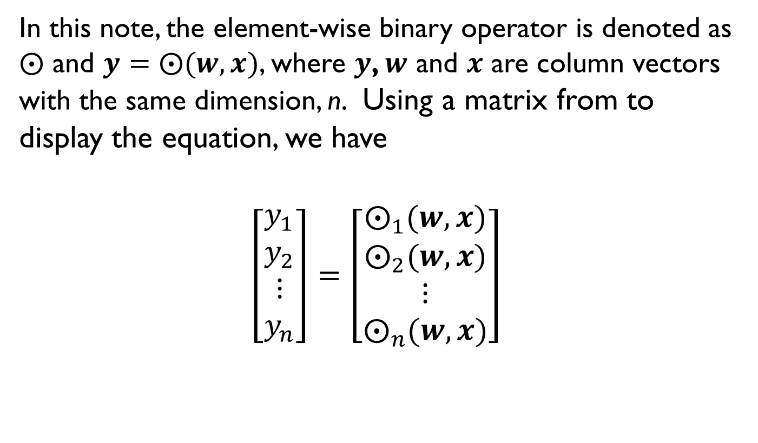
Derivatives of vector element-wise binary operators
In this note, the element-wise binary operator is denoted as $⨀$ and $y=⨀(w,x)$, where $y$, $w$ and $x$ are column vectors with the same dimension, n. Using a matrix from to display the equation, we have
$$\left[\begin{matrix}y_{1} \\ y_{2} \\ \begin{matrix}⋮ \\ y_{n}\end{matrix}\end{matrix}\right]=\left[\begin{matrix}⨀_{1}(w,x) \\ ⨀_{2}(w,x) \\ \begin{matrix}⋮ \\ ⨀_{n}(w,x)\end{matrix}\end{matrix}\right]$$

Slide 11
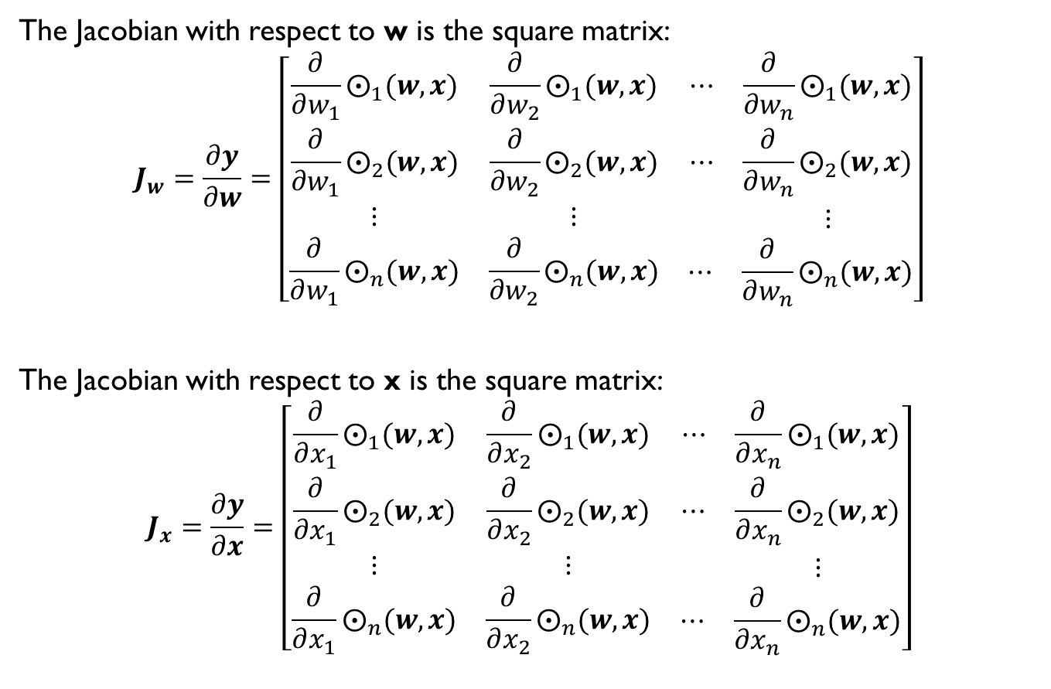
Derivatives of vector element-wise binary operators
The Jacobian with respect to w is the square matrix:
$$J_{w}=\frac{∂y}{∂w}=\left[\begin{matrix}\begin{matrix}\frac{∂}{∂w_{1}}⨀_{1}(w,x) \\ \frac{∂}{∂w_{1}}⨀_{2}(w,x)\end{matrix} & \begin{matrix}\frac{∂}{∂w_{2}}⨀_{1}(w,x) \\ \frac{∂}{∂w_{2}}⨀_{2}(w,x)\end{matrix} & \begin{matrix}\begin{matrix}⋯ & \frac{∂}{∂w_{n}}⨀_{1}(w,x)\end{matrix} \\ \begin{matrix}⋯ & \frac{∂}{∂w_{n}}⨀_{2}(w,x)\end{matrix}\end{matrix} \\ ⋮ & ⋮ & \begin{matrix} & ⋮\end{matrix} \\ \frac{∂}{∂w_{1}}⨀_{n}(w,x) & \frac{∂}{∂w_{2}}⨀_{n}(w,x) & \begin{matrix}⋯ & \frac{∂}{∂w_{n}}⨀_{n}(w,x)\end{matrix}\end{matrix}\right]$$
The Jacobian with respect to x is the square matrix:
$$J_{x}=\frac{∂y}{∂x}=\left[\begin{matrix}\begin{matrix}\frac{∂}{∂x_{1}}⨀_{1}(w,x) \\ \frac{∂}{∂x_{1}}⨀_{2}(w,x)\end{matrix} & \begin{matrix}\frac{∂}{∂x_{2}}⨀_{1}(w,x) \\ \frac{∂}{∂x_{2}}⨀_{2}(w,x)\end{matrix} & \begin{matrix}\begin{matrix}⋯ & \frac{∂}{∂x_{n}}⨀_{1}(w,x)\end{matrix} \\ \begin{matrix}⋯ & \frac{∂}{∂x_{n}}⨀_{2}(w,x)\end{matrix}\end{matrix} \\ ⋮ & ⋮ & \begin{matrix} & ⋮\end{matrix} \\ \frac{∂}{∂x_{1}}⨀_{n}(w,x) & \frac{∂}{∂x_{2}}⨀_{n}(w,x) & \begin{matrix}⋯ & \frac{∂}{∂x_{n}}⨀_{n}(w,x)\end{matrix}\end{matrix}\right]$$

Slide 12
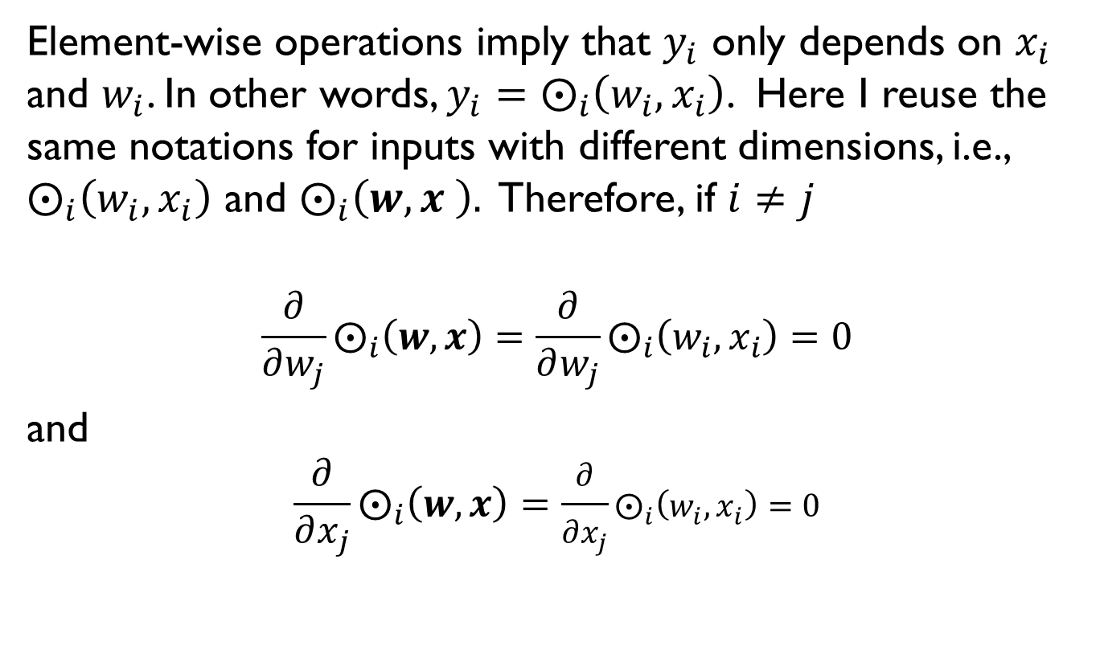
Derivatives of vector element-wise binary operators
Element-wise operations imply that $y_{i}$ only depends on $x_{i}$ and $w_{i}$. In other words, $y_{i}=⨀_{i}\left(w_{i},x_{i}\right)$. Here I reuse the same notations for inputs with different dimensions, i.e., $⨀_{i}\left(w_{i},x_{i}\right)$ and $⨀_{i}\left(w,x \right).$ Therefore, if $i≠j$
$$\frac{∂}{∂w_{j}}⨀_{i}\left(w,x\right)=\frac{∂}{∂w_{j}}⨀_{i}\left(w_{i},x_{i}\right)=0$$
and
$$\frac{∂}{∂x_{j}}⨀_{i}\left(w,x\right)=\frac{∂}{∂x_{j}}⨀_{i}\left(w_{i},x_{i}\right)=0$$

Slide 13
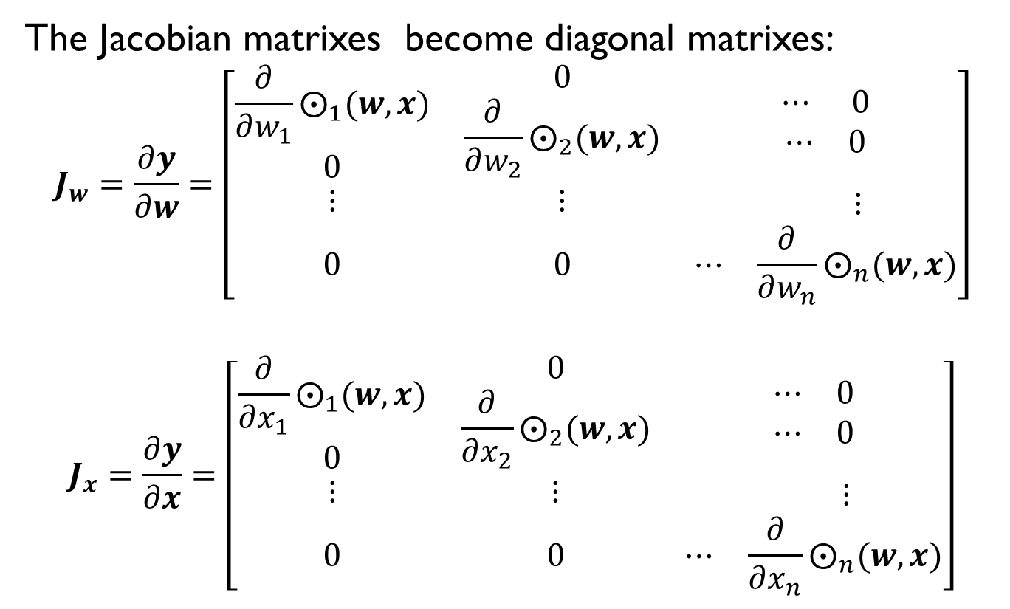
Derivatives of vector element-wise binary operators
The Jacobian matrixes become diagonal matrixes:
$$J_{w}=\frac{∂y}{∂w}=\left[\begin{matrix}\begin{matrix}\frac{∂}{∂w_{1}}⨀_{1}(w,x) \\ 0\end{matrix} & \begin{matrix}0 \\ \frac{∂}{∂w_{2}}⨀_{2}(w,x)\end{matrix} & \begin{matrix}\begin{matrix}⋯ & 0\end{matrix} \\ \begin{matrix}⋯ & 0\end{matrix}\end{matrix} \\ ⋮ & ⋮ & \begin{matrix} & ⋮\end{matrix} \\ 0 & 0 & \begin{matrix}⋯ & \frac{∂}{∂w_{n}}⨀_{n}(w,x)\end{matrix}\end{matrix}\right]$$
$$J_{x}=\frac{∂y}{∂x}=\left[\begin{matrix}\begin{matrix}\frac{∂}{∂x_{1}}⨀_{1}(w,x) \\ 0\end{matrix} & \begin{matrix}0 \\ \frac{∂}{∂x_{2}}⨀_{2}(w,x)\end{matrix} & \begin{matrix}\begin{matrix}⋯ & 0\end{matrix} \\ \begin{matrix}⋯ & 0\end{matrix}\end{matrix} \\ ⋮ & ⋮ & \begin{matrix} & ⋮\end{matrix} \\ 0 & 0 & \begin{matrix}⋯ & \frac{∂}{∂x_{n}}⨀_{n}(w,x)\end{matrix}\end{matrix}\right]$$

Slide 14
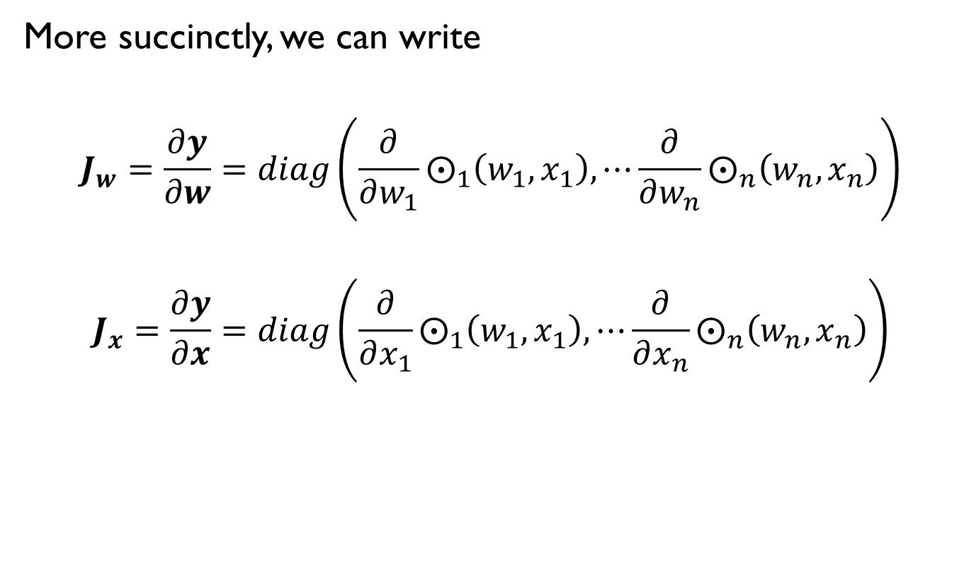
Derivatives of vector element-wise binary operators
More succinctly, we can write
$$J_{w}=\frac{∂y}{∂w}=diag\left(\frac{∂}{∂w_{1}}⨀_{1}\left(w_{1},x_{1}\right), ⋯\frac{∂}{∂w_{n}}⨀_{n}\left(w_{n},x_{n}\right)\right)$$
$$J_{x}=\frac{∂y}{∂x}=diag\left(\frac{∂}{∂x_{1}}⨀_{1}\left(w_{1},x_{1}\right), ⋯\frac{∂}{∂x_{n}}⨀_{n}\left(w_{n},x_{n}\right)\right)$$

Slide 15
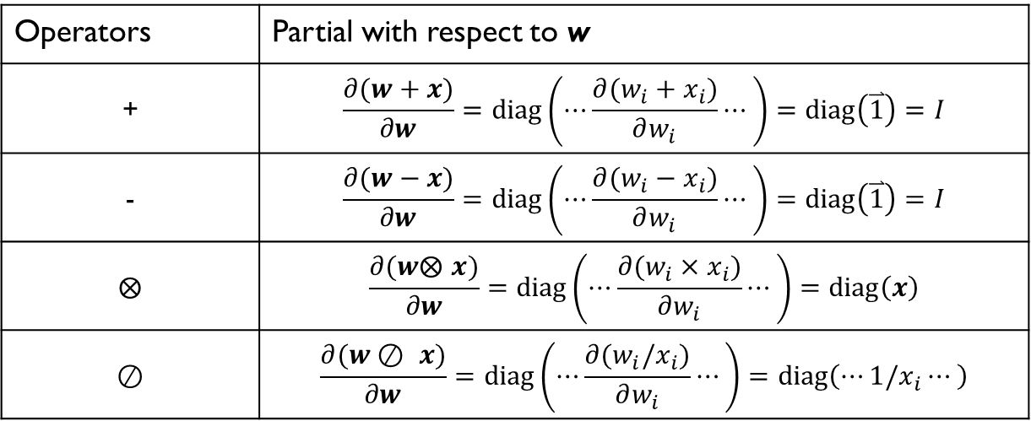
Examples
Operators | Partial with respect to w
+ | $$\frac{∂(w+x)}{∂w}=diag\left(⋯\frac{∂(w_{i}+x_{i})}{∂w_{i}}⋯\right)=diag\left(\overset{⃑}{1}\right)=I$$
- | $$\frac{∂(w−x)}{∂w}=diag\left(⋯\frac{∂(w_{i}−x_{i})}{∂w_{i}}⋯\right)=diag\left(\overset{⃑}{1}\right)=I$$
$$⨂$$ | $$\frac{∂(w⨂ x)}{∂w}=diag\left(⋯\frac{∂(w_{i}×x_{i})}{∂w_{i}}⋯\right)=diag\left(x\right)$$
$$⊘$$ | $$\frac{∂(w⊘ x)}{∂w}=diag\left(⋯\frac{∂(w_{i}/x_{i})}{∂w_{i}}⋯\right)=diag\left(⋯1/x_{i}⋯\right)$$

Slide 16
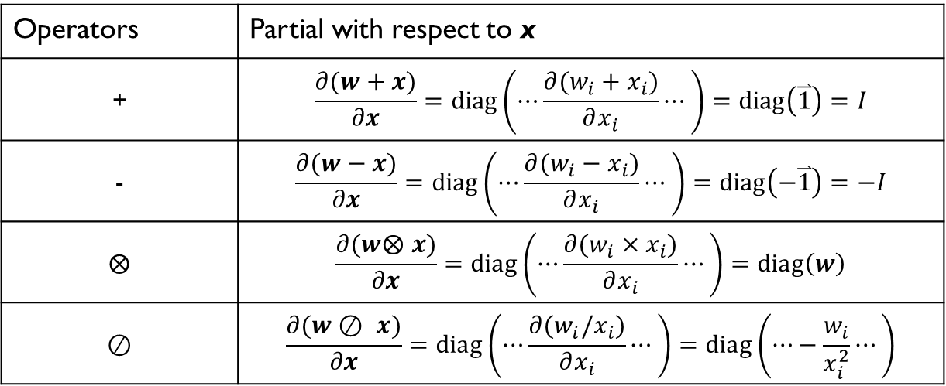
Examples
Operators | Partial with respect to x
+ | $$\frac{∂(w+x)}{∂x}=diag\left(⋯\frac{∂(w_{i}+x_{i})}{∂x_{i}}⋯\right)=diag\left(\overset{⃑}{1}\right)=I$$
- | $$\frac{∂(w−x)}{∂x}=diag\left(⋯\frac{∂(w_{i}−x_{i})}{∂x_{i}}⋯\right)=diag\left(−\overset{⃑}{1}\right)=−I$$
$$⨂$$ | $$\frac{∂(w⨂ x)}{∂x}=diag\left(⋯\frac{∂(w_{i}×x_{i})}{∂x_{i}}⋯\right)=diag\left(w\right)$$
$$⊘$$ | $$\frac{∂(w⊘ x)}{∂x}=diag\left(⋯\frac{∂(w_{i}/x_{i})}{∂x_{i}}⋯\right)=diag\left(⋯−\frac{w_{i}}{x_{i}^{2}}⋯\right)$$

Slide 17
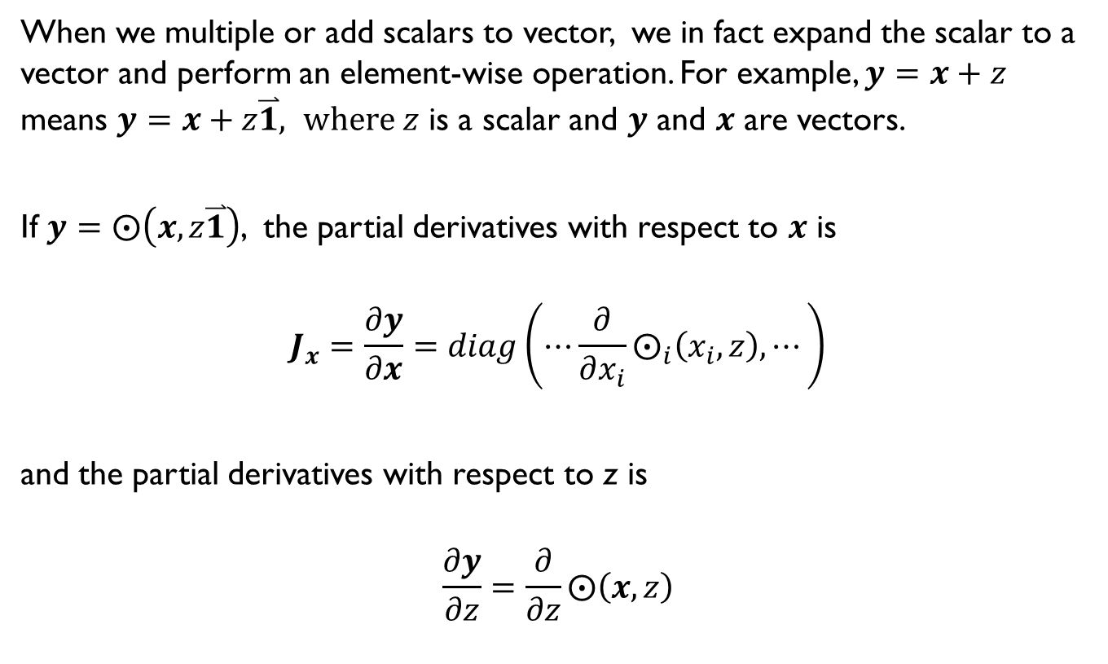
Derivatives involving scalar expansion
When we multiple or add scalars to vector, we in fact expand the scalar to a vector and perform an element-wise operation. For example, $y=x+z$ means $y=x+z\overset{⃑}{1}, where z$ is a scalar and $y$ and $x$ are vectors.
If $y=⨀\left(x,z\overset{⃑}{1}\right)$, the partial derivatives with respect to $x$ is
$$J_{x}=\frac{∂y}{∂x}=diag\left(⋯\frac{∂}{∂x_{i}}⨀_{i}\left(x_{i},z\right), ⋯\right)$$
and the partial derivatives with respect to z is
$$\frac{∂y}{∂z}=\frac{∂}{∂z}⨀\left(x,z\right)$$

Slide 18
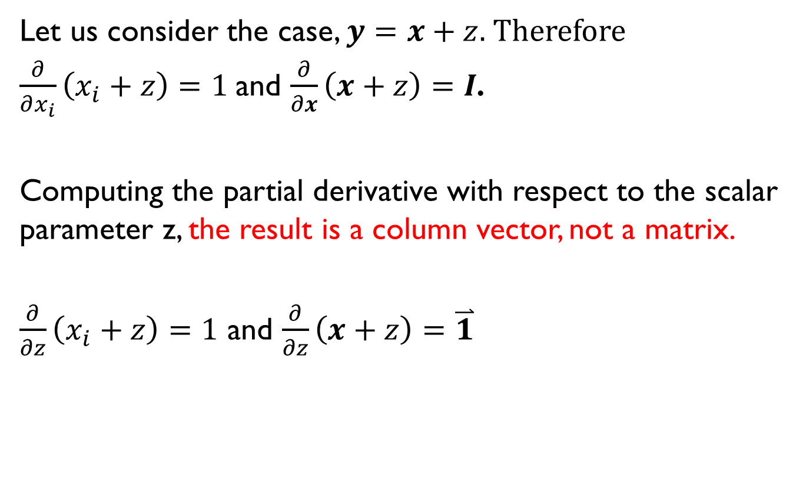
Example
Let us consider the case, $y=x+z.$ Therefore
$\frac{∂}{∂x_{i}}\left(x_{i}+z\right)=1$and $\frac{∂}{∂x}\left(x+z\right)=I$.
Computing the partial derivative with respect to the scalar parameter z, the result is a column vector, not a matrix.
$\frac{∂}{∂z}\left(x_{i}+z\right)=1$ and $\frac{∂}{∂z}\left(x+z\right)=\overset{⃑}{1}$

Slide 19

Example
Let us consider the case, $y=zx$, where z is a scalar and y and x are vectors. Since $\frac{∂}{∂x_{i}}zx_{i}=z,$
$\frac{∂}{∂x}$ $zx=diag\left(z\overset{⃑}{1}\right)=zI$
Since $\frac{∂}{∂z}zx_{i}=x_{i},$ $\frac{∂}{∂z}$ $zx=x$

Slide 20
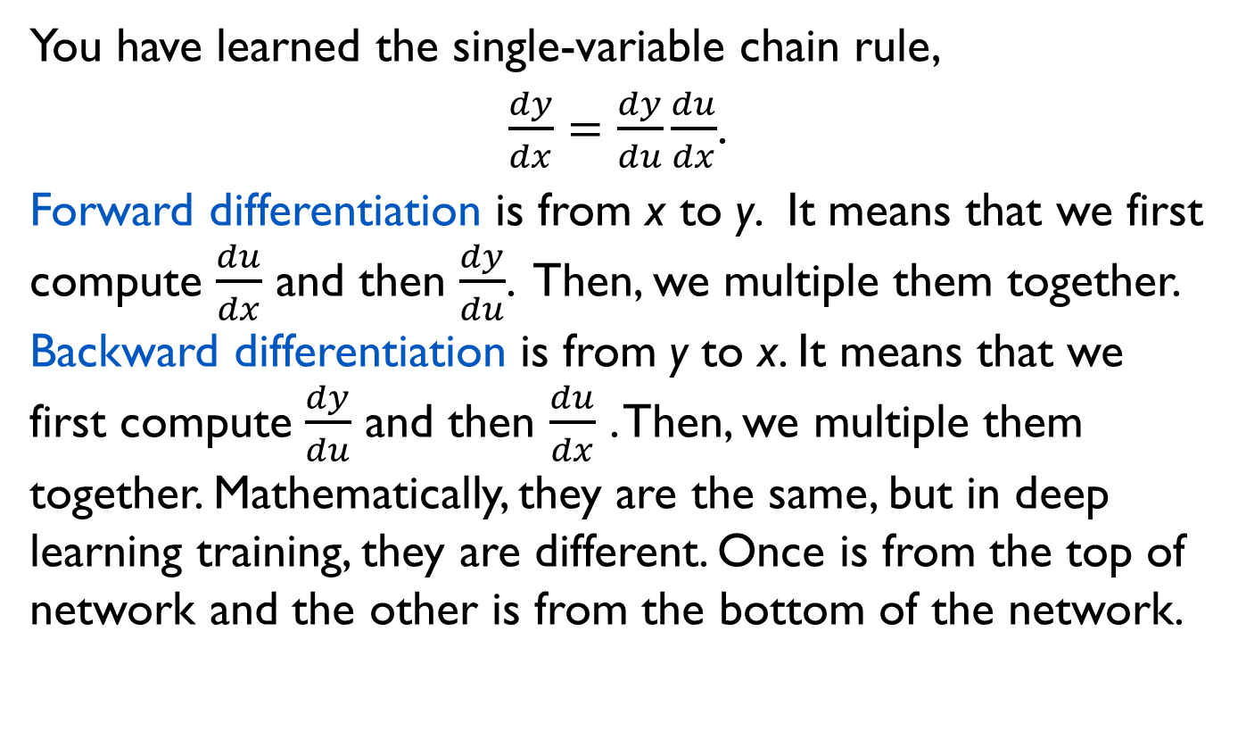
The Chain Rules
You have learned the single-variable chain rule,
$\frac{dy}{dx}=\frac{dy}{du}\frac{du}{dx}$.
Forward differentiation is from x to y. It means that we first compute $\frac{du}{dx}$ and then $\frac{dy}{du}$. Then, we multiple them together. Backward differentiation is from y to x. It means that we first compute $\frac{dy}{du}$ and then $\frac{du}{dx}$ . Then, we multiple them together. Mathematically, they are the same, but in deep learning training, they are different. Once is from the top of network and the other is from the bottom of the network.

Slide 21
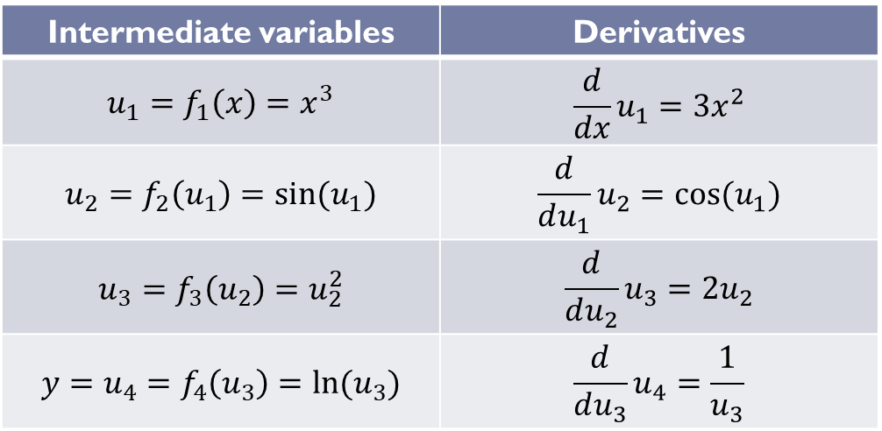

Example
Compute $\frac{dy}{dx}$ if $y=f\left(x\right)=\ln\left({\sin\left(x^{3}\right)}^{2}\right)$
Apply $\frac{dy}{dx}=\frac{du_{4}}{du_{3}}\frac{du_{3}}{du_{2}}\frac{du_{2}}{du_{1}}\frac{du_{1}}{dx}=\frac{6u_{2}x^{2}cos⁡(u_{1})}{u_{3}}$
Substitute $\frac{dy}{dx}=$ $\frac{6sin⁡(u_{1})x^{2}cos⁡(x^{3})}{u_{2}^{2}}=\frac{6sin⁡(x^{3})x^{2}cos⁡(x^{3})}{{sin⁡(u_{1})}^{2}}=\frac{6x^{2}cos⁡(x^{3})}{sin⁡(x^{3})}$
Intermediate variables | Derivatives
$$u_{1}=f_{1}\left(x\right)=x^{3}$$ | $$\frac{d}{dx}u_{1}=3x^{2}$$
$$u_{2}=f_{2}\left(u_{1}\right)=sin⁡(u_{1})$$ | $$\frac{d}{du_{1}}u_{2}=cos⁡(u_{1})$$
$$u_{3}=f_{3}\left(u_{2}\right)=u_{2}^{2}$$ | $$\frac{d}{du_{2}}u_{3}=2u_{2}$$
$${y=u}_{4}=f_{4}\left(u_{3}\right)=ln(u_{3})$$ | $$\frac{d}{du_{3}}u_{4}=\frac{1}{u_{3}}$$

Slide 22
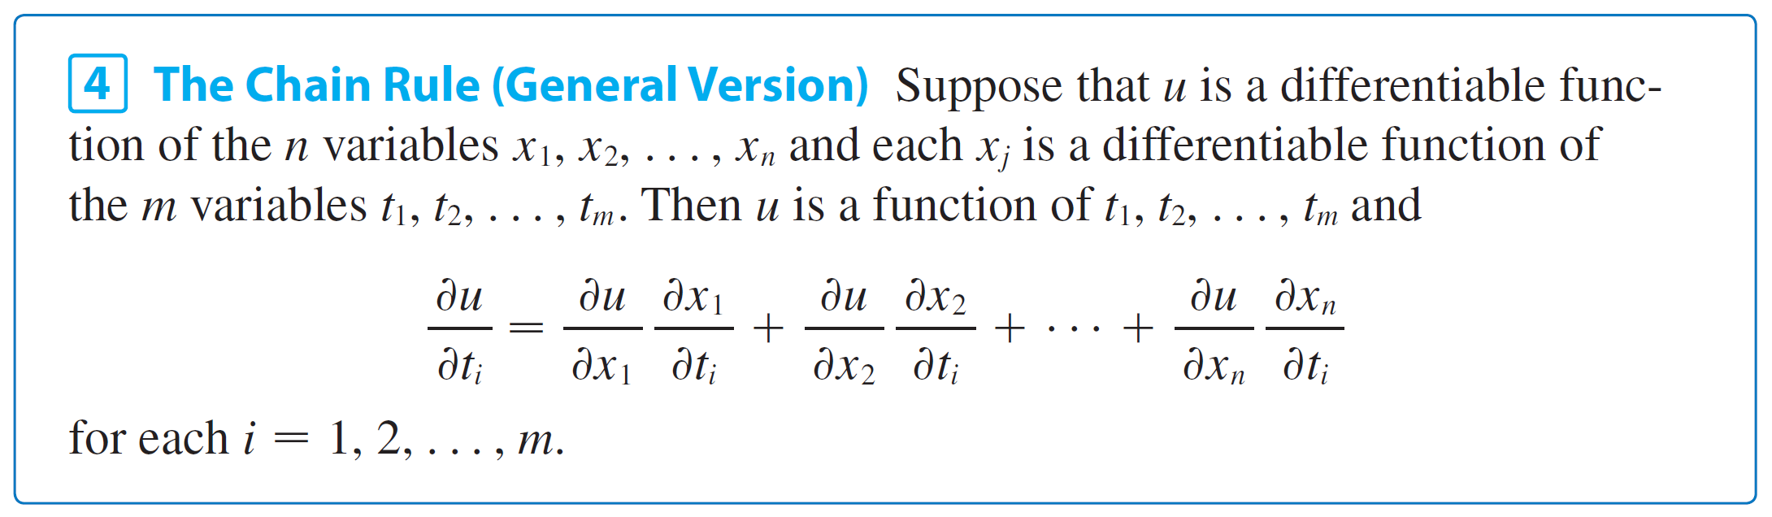
Single-variable total-derivative chain rule
Note that u is a function with one dimensional output.

Slide 23
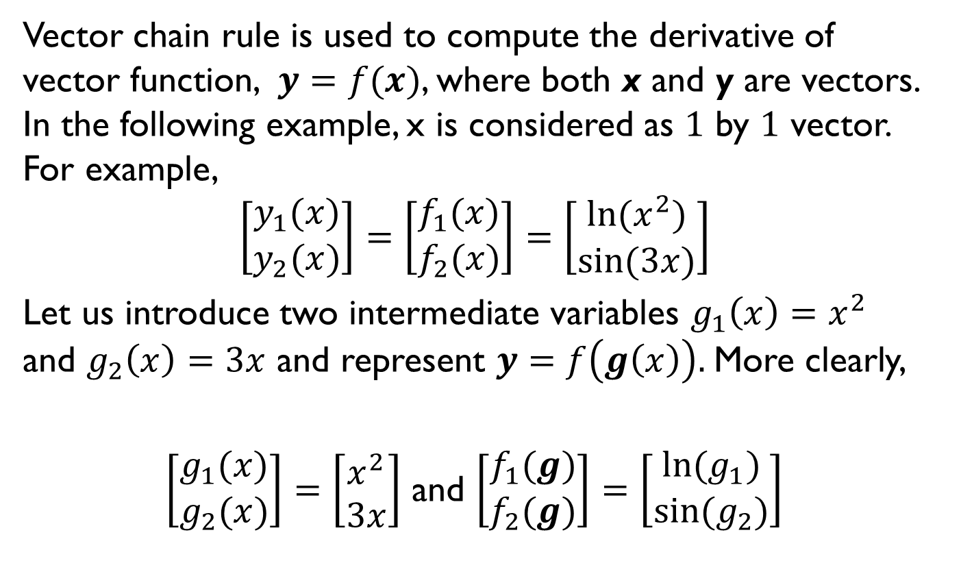
Vector chain rule
Vector chain rule is used to compute the derivative of vector function, $y=f(x)$, where both x and y are vectors. In the following example, x is considered as $1$ by $1$ vector. For example,
$$\left[\begin{matrix}y_{1}(x) \\ y_{2}(x)\end{matrix}\right]=\left[\begin{matrix}f_{1}(x) \\ f_{2}(x)\end{matrix}\right]=\left[\begin{matrix}ln⁡(x^{2}) \\ sin⁡(3x)\end{matrix}\right]$$
Let us introduce two intermediate variables $g_{1}\left(x\right)=x^{2}$ and $g_{2}\left(x\right)=3x$ and represent $y=f\left(g\left(x\right)\right).$More clearly,
$\left[\begin{matrix}g_{1}(x) \\ g_{2}(x)\end{matrix}\right]=\left[\begin{matrix}x^{2} \\ 3x\end{matrix}\right]$ and $\left[\begin{matrix}f_{1}(g) \\ f_{2}(g)\end{matrix}\right]=\left[\begin{matrix}ln⁡(g_{1}) \\ sin⁡(g_{2})\end{matrix}\right]$

Slide 24
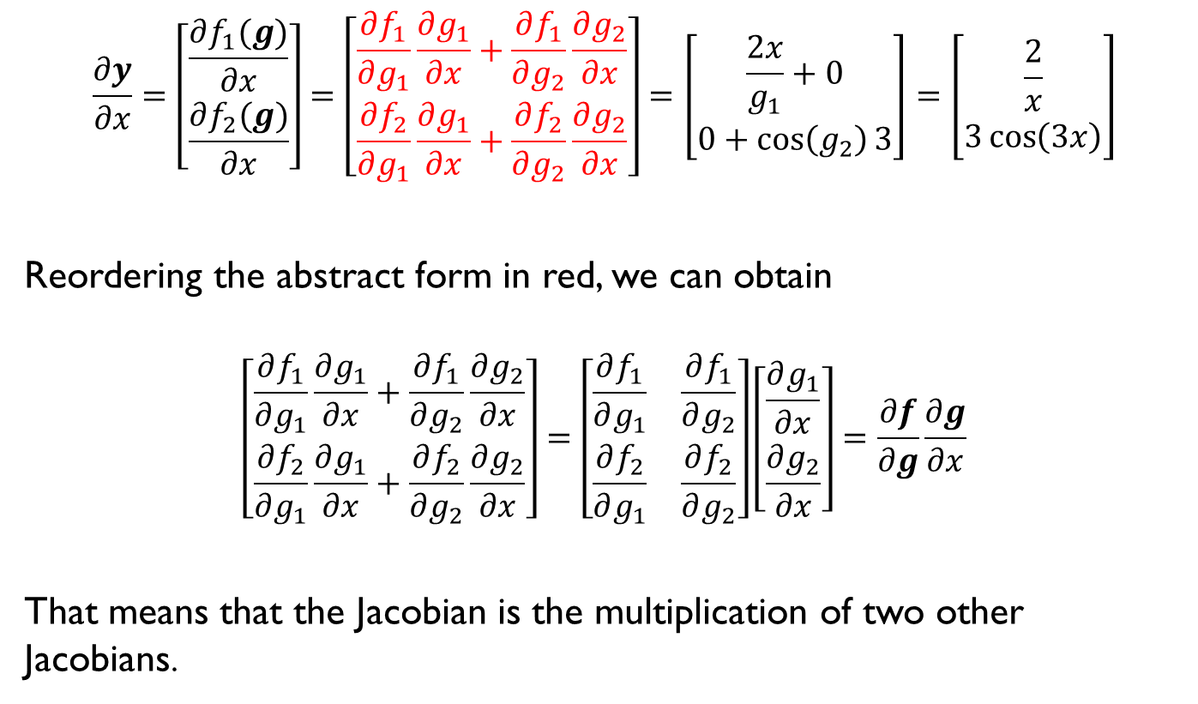
Vector chain rule
$$\frac{∂y}{∂x}=\left[\begin{matrix}\frac{∂f_{1}(g)}{∂x} \\ \frac{∂f_{2}(g)}{∂x}\end{matrix}\right]=\left[\begin{matrix}\frac{∂f_{1}}{∂g_{1}}\frac{∂g_{1}}{∂x}+\frac{∂f_{1}}{∂g_{2}}\frac{∂g_{2}}{∂x} \\ \frac{∂f_{2}}{∂g_{1}}\frac{∂g_{1}}{∂x}+\frac{∂f_{2}}{∂g_{2}}\frac{∂g_{2}}{∂x}\end{matrix}\right]=\left[\begin{matrix}\frac{2x}{g_{1}}+0 \\ 0+\cos\left(g_{2}\right)3\end{matrix}\right]=\left[\begin{matrix}\frac{2}{x} \\ 3\cos\left(3x\right)\end{matrix}\right]$$
Reordering the abstract form in red, we can obtain
$$\left[\begin{matrix}\frac{∂f_{1}}{∂g_{1}}\frac{∂g_{1}}{∂x}+\frac{∂f_{1}}{∂g_{2}}\frac{∂g_{2}}{∂x} \\ \frac{∂f_{2}}{∂g_{1}}\frac{∂g_{1}}{∂x}+\frac{∂f_{2}}{∂g_{2}}\frac{∂g_{2}}{∂x}\end{matrix}\right]=\left[\begin{matrix}\frac{∂f_{1}}{∂g_{1}} & \frac{∂f_{1}}{∂g_{2}} \\ \frac{∂f_{2}}{∂g_{1}} & \frac{∂f_{2}}{∂g_{2}}\end{matrix}\right]\left[\begin{matrix}\frac{∂g_{1}}{∂x} \\ \frac{∂g_{2}}{∂x}\end{matrix}\right]=\frac{∂f}{∂g}\frac{∂g}{∂x}$$
That means that the Jacobian is the multiplication of two other Jacobians.

Slide 25
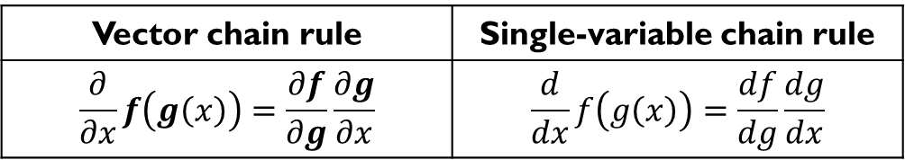

Vector chain rule
Let us check the results in the example
$\frac{∂f}{∂g}\frac{∂g}{∂x}$= $\left[\begin{matrix}\frac{1}{g_{1}} & 0 \\ 0 & cos⁡(g_{2})\end{matrix}\right]\left[\begin{matrix}2x \\ 3\end{matrix}\right]=\left[\begin{matrix}\frac{1}{g_{1}}2x+0 \\ 0+\cos\left(g_{2}\right)3\end{matrix}\right]=\left[\begin{matrix}\frac{2}{x} \\ 3cos⁡(3x)\end{matrix}\right]$
The vector chain rule and the single-variable chain rule have the same form.
Vector chain rule | Single-variable chain rule
$$\frac{∂}{∂x}f\left(g\left(x\right)\right)=\frac{∂f}{∂g}\frac{∂g}{∂x}$$ | $$\frac{d}{dx}f\left(g\left(x\right)\right)=\frac{df}{dg}\frac{dg}{dx}$$

Slide 26
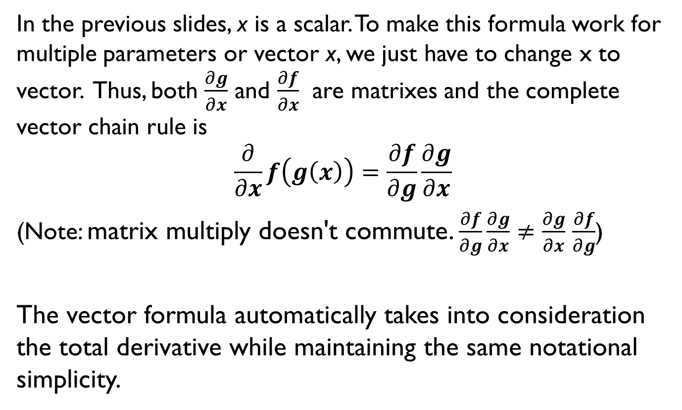
Vector chain rule
In the previous slides, x is a scalar. To make this formula work for multiple parameters or vector x, we just have to change x to vector. Thus, both $\frac{∂g}{∂x}$ and $\frac{∂f}{∂x}$ are matrixes and the complete vector chain rule is
$$\frac{∂}{∂x}f\left(g\left(x\right)\right)=\frac{∂f}{∂g}\frac{∂g}{∂x}$$
(Note: matrix multiply doesn't commute. $\frac{∂f}{∂g}\frac{∂g}{∂x}≠$ $\frac{∂g}{∂x}$ $\frac{∂f}{∂g}$)
The vector formula automatically takes into consideration the total derivative while maintaining the same notational simplicity.

Slide 27
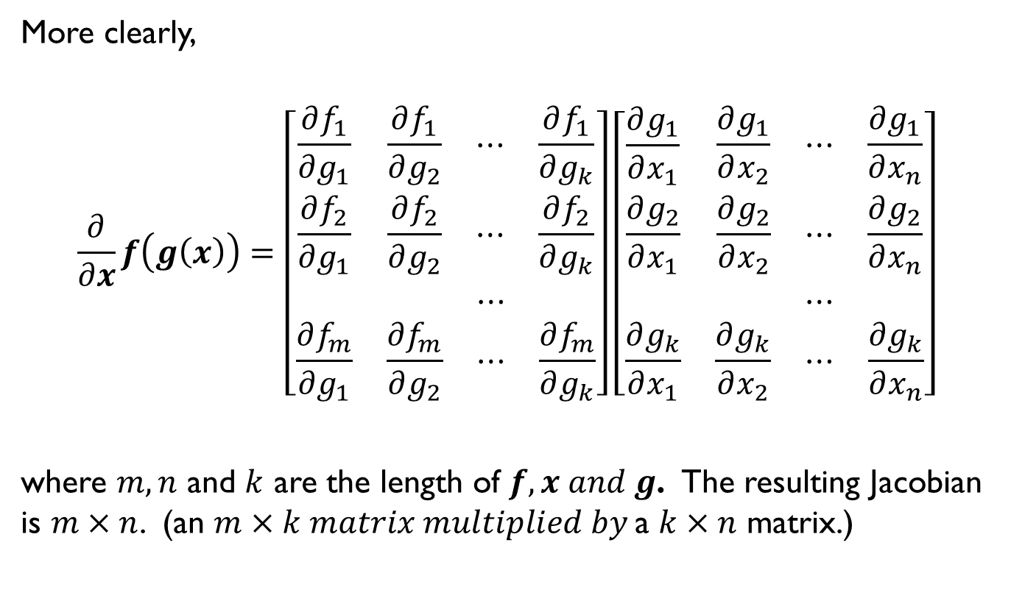
Vector chain rule
More clearly,
$$\frac{∂}{∂x}f\left(g\left(x\right)\right)=\left[\begin{matrix}\begin{matrix}\frac{∂f_{1}}{∂g_{1}} \\ \frac{∂f_{2}}{∂g_{1}}\end{matrix} & \begin{matrix}\begin{matrix}\frac{∂f_{1}}{∂g_{2}} & ⋯ & \frac{∂f_{1}}{∂g_{k}}\end{matrix} \\ \begin{matrix}\frac{∂f_{2}}{∂g_{2}} & ⋯ & \frac{∂f_{2}}{∂g_{k}}\end{matrix}\end{matrix} \\ \begin{matrix} \\ \frac{∂f_{m}}{∂g_{1}}\end{matrix} & \begin{matrix}\begin{matrix} & ⋯ & \end{matrix} \\ \begin{matrix}\frac{∂f_{m}}{∂g_{2}} & ⋯ & \frac{∂f_{m}}{∂g_{k}}\end{matrix}\end{matrix}\end{matrix}\right]\left[\begin{matrix}\begin{matrix}\frac{∂g_{1}}{∂x_{1}} \\ \frac{∂g_{2}}{∂x_{1}}\end{matrix} & \begin{matrix}\begin{matrix}\frac{∂g_{1}}{∂x_{2}} & ⋯ & \frac{∂g_{1}}{∂x_{n}}\end{matrix} \\ \begin{matrix}\frac{∂g_{2}}{∂x_{2}} & ⋯ & \frac{∂g_{2}}{∂x_{n}}\end{matrix}\end{matrix} \\ \begin{matrix} \\ \frac{∂g_{k}}{∂x_{1}}\end{matrix} & \begin{matrix}\begin{matrix} & ⋯ & \end{matrix} \\ \begin{matrix}\frac{∂g_{k}}{∂x_{2}} & ⋯ & \frac{∂g_{k}}{∂x_{n}}\end{matrix}\end{matrix}\end{matrix}\right]$$
where $m, n$ and $k$ are the length of $f, x and g$. The resulting Jacobian is $m×n$. (an $m×k matrix multiplied by$a $k×n$ matrix.)

Slide 28

Vector chain rule
The figure below summarizes the shapes of the Jacobian, where $u=g(x)$.

Slide 29
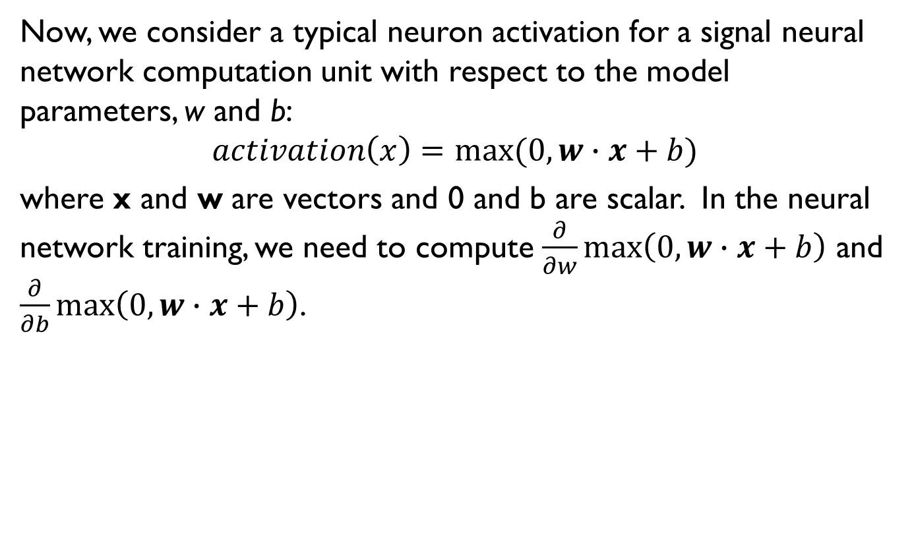
The gradient of neuron activation
Now, we consider a typical neuron activation for a signal neural network computation unit with respect to the model parameters, w and b:
$$activation\left(x\right)=max⁡(0, w∙x+b)$$
where x and w are vectors and 0 and b are scalar. In the neural network training, we need to compute $\frac{∂}{∂w}\max\left(0, w∙x+b\right)$ and $\frac{∂}{∂b}\max\left(0, w∙x+b\right)$.

Slide 30
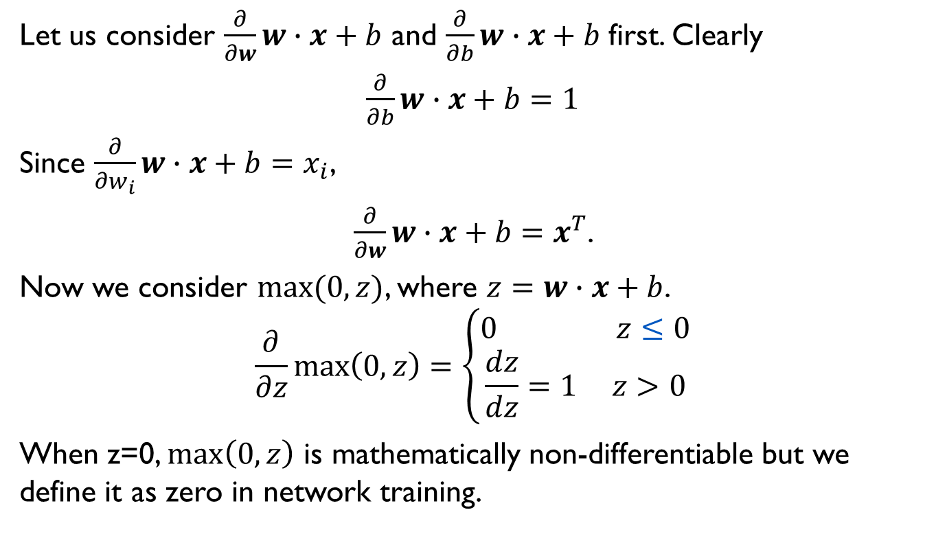
The gradient of neuron activation
Let us consider $\frac{∂}{∂w}w∙x+b$ and $\frac{∂}{∂b}w∙x+b$ first. Clearly
$\frac{∂}{∂b}w∙x+b=1$
Since $\frac{∂}{∂w_{i}}w∙x+b=x_{i}$,
$\frac{∂}{∂w}w∙x+b=x^{T}$.
Now we consider $max(0,z)$, where $z=w∙x+b$.
$$\frac{∂}{∂z}\max\left(0,z\right)=\left\{\begin{aligned}0 z≤0 \\ \frac{dz}{dz}=1 z>0\end{aligned}\right.$$
When z=0, $\max\left(0,z\right)$ is mathematically non-differentiable but we define it as zero in network training.

Slide 31
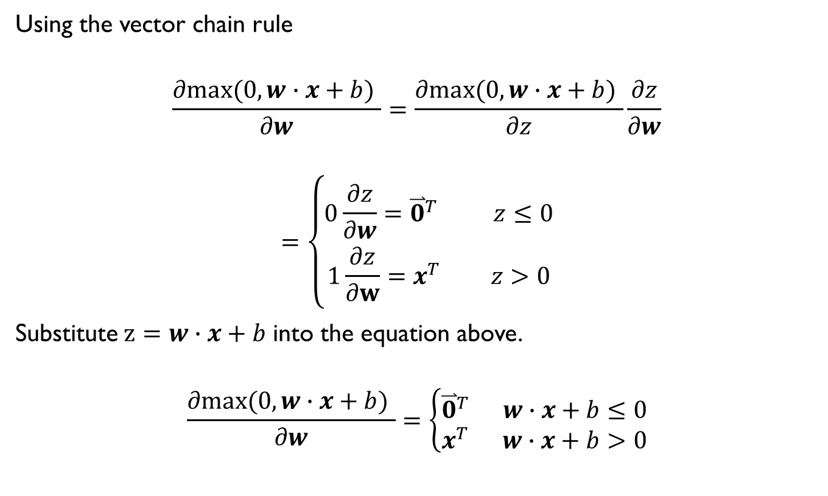
The gradient of neuron activation
Using the vector chain rule
$$\frac{∂max⁡(0, w∙x+b) }{∂w}=\frac{∂max⁡(0, w∙x+b) }{∂z}\frac{∂z}{∂w}$$
$$=\left\{\begin{aligned}0\frac{∂z}{∂w}={\overset{⃑}{0}}^{T} z≤0 \\ 1\frac{∂z}{∂w}=x^{T} z>0\end{aligned}\right.$$
Substitute$z=w∙x+b$ into the equation above.
$$\frac{∂max⁡(0, w∙x+b) }{∂w}=\left\{\begin{aligned}{\overset{⃑}{0}}^{T} w∙x+b≤0 \\ x^{T} w∙x+b>0\end{aligned}\right.$$

Slide 32

The gradient of neuron activation
Now we consider the derivative of the neuron activation with respect to b.
$$\frac{∂max⁡(0, w∙x+b) }{∂b}=\left\{\begin{aligned}0\frac{∂z}{∂b}=0 w∙x+b≤0 \\ 1\frac{∂z}{∂b}=1 w∙x+b>0\end{aligned}\right.$$

Slide 33
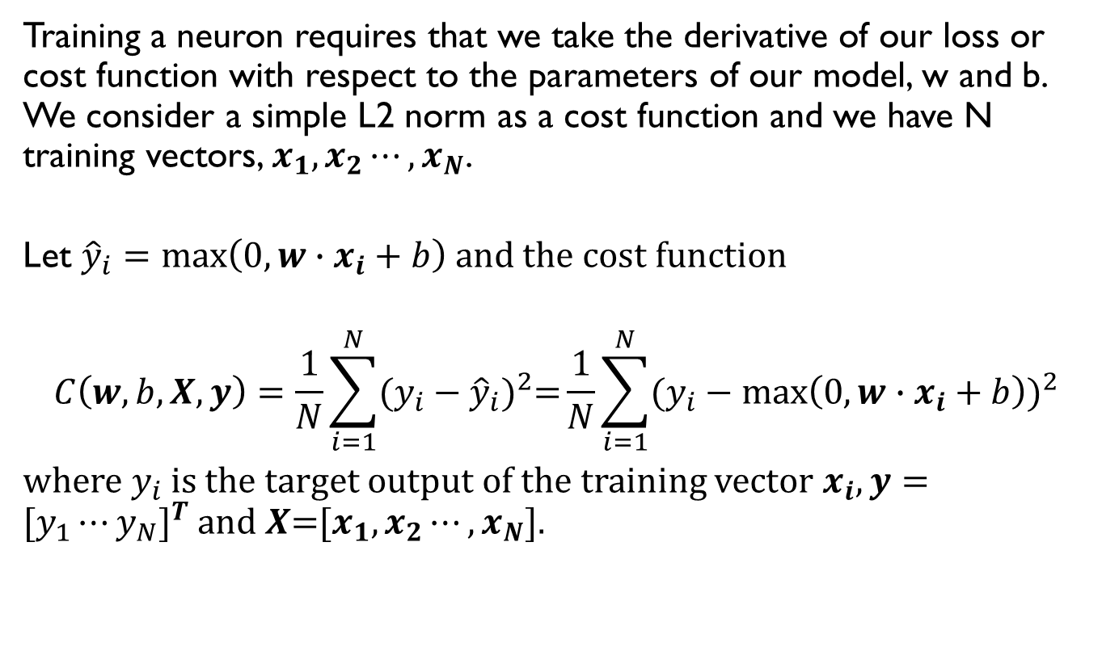
The gradient of the neural network loss function
Training a neuron requires that we take the derivative of our loss or cost function with respect to the parameters of our model, w and b. We consider a simple L2 norm as a cost function and we have N training vectors, $x_{1},x_{2}⋯,x_{N}$.
Let ${\hat{y}}_{i}=\max\left(0, w∙x_{i}+b\right)$ and the cost function
$$C\left(w,b,X,y\right)=\frac{1}{N}\sum_{i=1}^{N}{{(y_{i}−{\hat{y}}_{i})}^{2}=}\frac{1}{N}\sum_{i=1}^{N}{{(y_{i}−\max\left(0, w∙x_{i}+b\right))}^{2}}$$
where $y_{i}$ is the target output of the training vector $x_{i}, y={[y_{1}⋯y_{N}]}^{T}$ and $X$=[$x_{1},x_{2}⋯,x_{N}$].

Slide 34
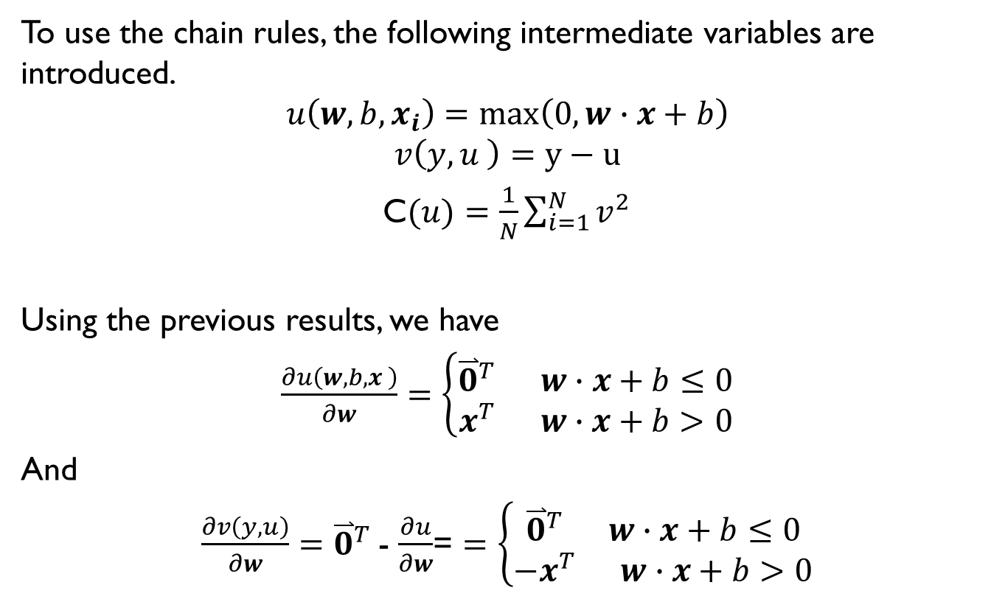
The gradient of the neural network loss function
To use the chain rules, the following intermediate variables are introduced.
$$u\left(w, b,x_{i}\right)=max\left(0,w∙x+b\right)$$
$$v\left(y,u \right)=y−u$$
C$(u)=\frac{1}{N}\sum_{i=1}^{N}{v^{2}}$
Using the previous results, we have
$\frac{∂u\left(w, b,x \right)}{∂w}=\left\{\begin{aligned}{\overset{⃑}{0}}^{T} w∙x+b≤0 \\ x^{T} w∙x+b>0\end{aligned}\right.$
And
$\frac{∂v\left(y,u\right)}{∂w}=$ ${\overset{⃑}{0}}^{T}$- $\frac{∂u}{∂w}$= $=\left\{\begin{aligned}{\overset{⃑}{0}}^{T} w∙x+b≤0 \\ {−x}^{T} w∙x+b>0\end{aligned}\right.$

Slide 35
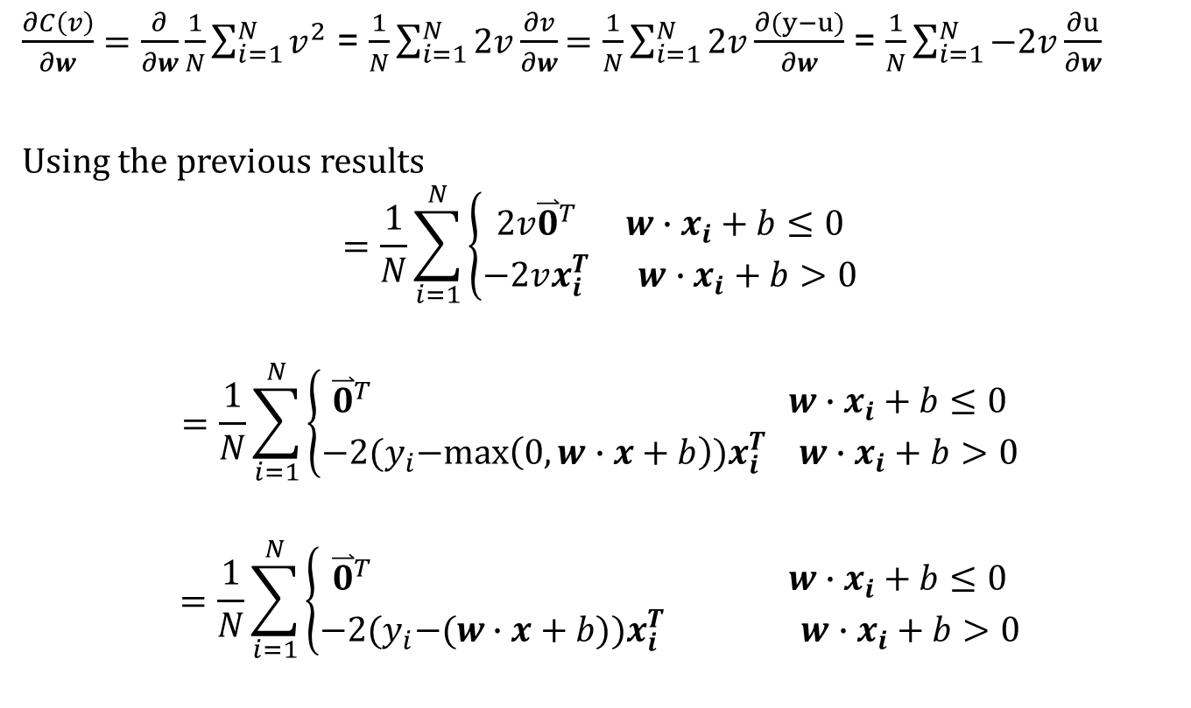
The gradient of the neural network loss function
$\frac{∂C\left(v\right)}{∂w}=\frac{∂}{∂w}\frac{1}{N}\sum_{i=1}^{N}{v^{2}}$ = $\frac{1}{N}\sum_{i=1}^{N}{2v\frac{∂v}{∂w}}$ = $\frac{1}{N}\sum_{i=1}^{N}{2v\frac{∂(y−u)}{∂w}}$ = $\frac{1}{N}\sum_{i=1}^{N}{−2v\frac{∂u}{∂w}}$
Using the previous results
$$=\frac{1}{N}\sum_{i=1}^{N}{\left\{\begin{aligned}2v{\overset{⃑}{0}}^{T} w∙x_{i}+b≤0 \\ −2vx_{i}^{T} w∙x_{i}+b>0\end{aligned}\right.}$$
$$=\frac{1}{N}\sum_{i=1}^{N}{\left\{\begin{aligned}{\overset{⃑}{0}}^{T} w∙x_{i}+b≤0 \\ −2{(y}_{i}−max\left(0,w∙x+b\right))x_{i}^{T} w∙x_{i}+b>0\end{aligned}\right.}$$
$$=\frac{1}{N}\sum_{i=1}^{N}{\left\{\begin{aligned}{\overset{⃑}{0}}^{T} w∙x_{i}+b≤0 \\ −2{(y}_{i}−(w∙x+b))x_{i}^{T} w∙x_{i}+b>0\end{aligned}\right.}$$

Slide 36

The gradient of the neural network loss function
$\frac{∂C\left(v\right)}{∂b}=\frac{∂}{∂b}\frac{1}{N}\sum_{i=1}^{N}{v^{2}}$= $\frac{1}{N}\sum_{i=1}^{N}{2v\frac{∂v}{∂b}}$ = $\frac{1}{N}\sum_{i=1}^{N}{2v\frac{∂(y−u)}{∂b}}$ =$\frac{1}{N}\sum_{i=1}^{N}{−2v\frac{∂u}{∂b}}$
= $\frac{1}{N}\sum_{i=1}^{N}{\left\{\begin{aligned}−2v×0 w∙x_{i}+b≤0 \\ −2v×1 w∙x_{i}+b>0\end{aligned}\right.}$
= $\frac{1}{N}\sum_{i=1}^{N}{\left\{\begin{aligned}0 w∙x_{i}+b≤0 \\ 2×(w∙x_{i}+b−y_{i}) w∙x_{i}+b>0\end{aligned}\right.}$

Slide 37
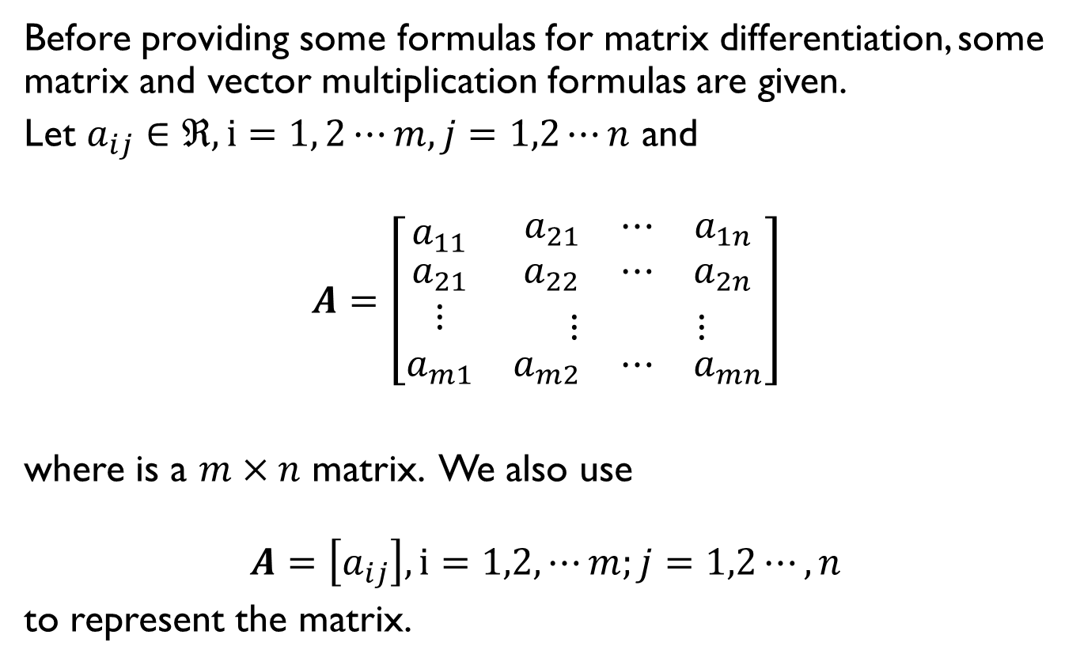
Some matrix differentiation formulas
Before providing some formulas for matrix differentiation, some matrix and vector multiplication formulas are given.
Let $a_{ij}∈ℜ, i=1, 2⋯m, j=1,2⋯n$ and
$$A=\left[\begin{matrix}a_{11} & \begin{matrix}a_{21} & ⋯ & a_{1n}\end{matrix} \\ \begin{matrix}a_{21} \\ ⋮ \\ a_{m1}\end{matrix} & \begin{matrix}\begin{matrix}a_{22} & ⋯ & a_{2n}\end{matrix} \\ \begin{matrix}⋮ & & ⋮\end{matrix} \\ \begin{matrix}a_{m2} & ⋯ & a_{mn}\end{matrix}\end{matrix}\end{matrix}\right]$$
where is a $m×n$ matrix. We also use
$$A=\left[a_{ij}\right], i=1,2,⋯m;j=1,2⋯,n$$
to represent the matrix.

Slide 38

Some matrix differentiation formulas
Let A be $m×n$ , and B be $n×p$, and let the product AB be
$$C=AB$$
C is an $m×p$ matrix and its element at $(i,j)$ is
$c_{ij}=\sum_{k=1}^{n}{a_{ik}b_{kj}}$
for all $i=1,2,⋯m and j=1,2⋯,p$.

Slide 39
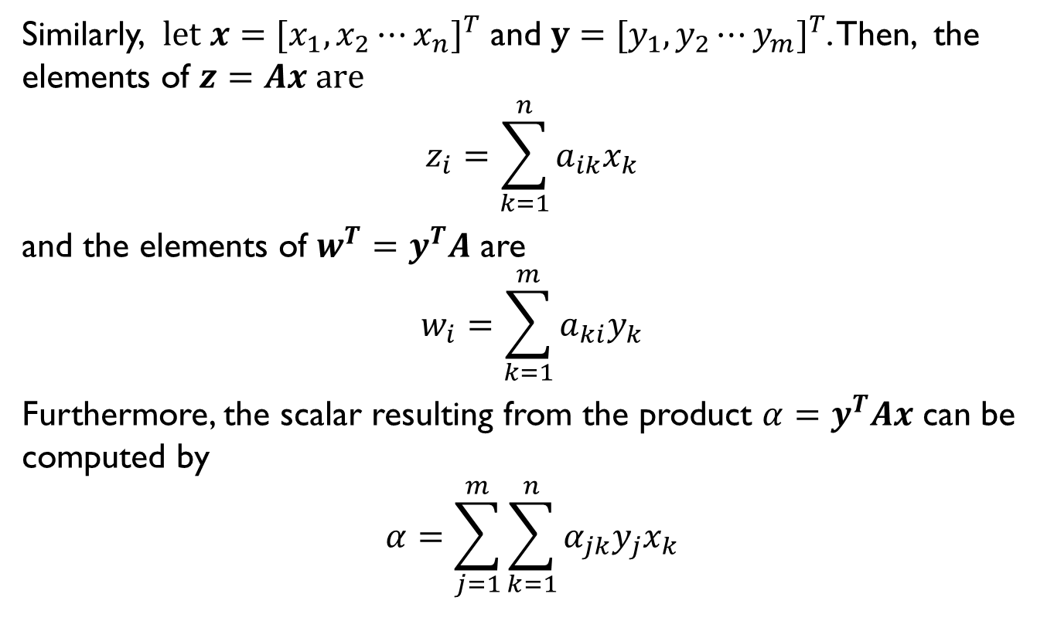
Some matrix differentiation formulas
Similarly, $let x={[x_{1},x_{2}⋯x_{n}]}^{T}$ and $y={[y_{1},y_{2}⋯y_{m}]}^{T}$. Then, the elements of $z=Ax are$
$$z_{i}=\sum_{k=1}^{n}{a_{ik}x_{k}}$$
and the elements of $w^{T}=y^{T}A$ are
$$w_{i}=\sum_{k=1}^{m}{a_{ki}y_{k}}$$
Furthermore, the scalar resulting from the product $α=y^{T}Ax$ can be computed by
$$α=\sum_{j=1}^{m}{\sum_{k=1}^{n}{α_{jk}y_{j}x_{k}}}$$

Slide 40

Some matrix differentiation formulas
Given $z=Ax,$ then $\frac{∂}{∂x}z=A$
Proof: Using $z_{i}=\sum_{k=1}^{n}{a_{ik}x_{k}}$,
$$\frac{∂}{∂x_{j}}z_{i}=\sum_{k=1}^{n}{a_{ik}\frac{∂}{∂x_{j}}x_{k}=a_{ij}}$$
Thus, $\frac{∂}{∂x}z=A$.

Slide 41
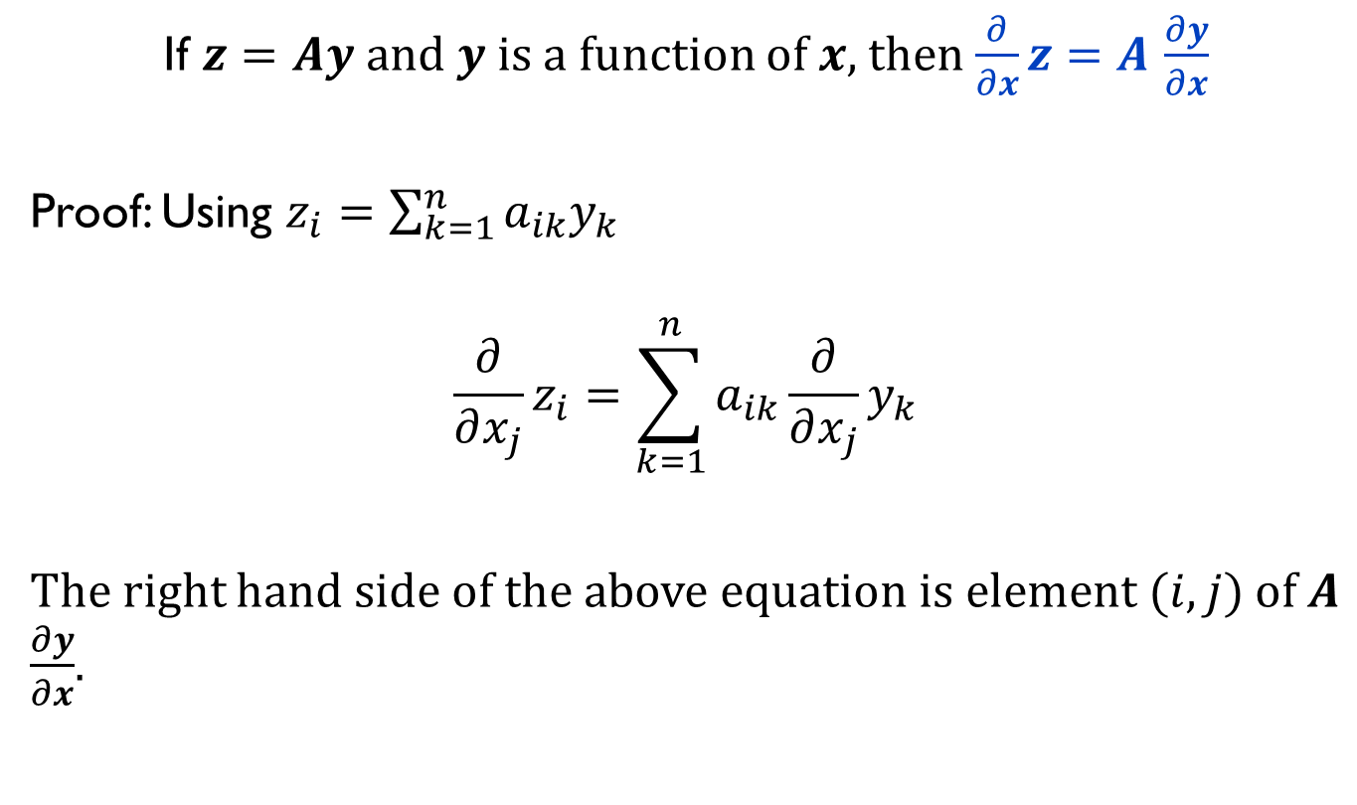
Some matrix differentiation formulas
If $z=Ay$and $y$ is a function of $x,$then $\frac{∂}{∂x}z=A$ $\frac{∂y}{∂x}$
Proof: Using $z_{i}=\sum_{k=1}^{n}{a_{ik}y_{k}}$
$$\frac{∂}{∂x_{j}}z_{i}=\sum_{k=1}^{n}{a_{ik}\frac{∂}{∂x_{j}}y_{k}}$$
The right hand side of the above equation is element $(i,j)$ of $A$ $\frac{∂y}{∂x}$.

Slide 42

Some matrix differentiation formulas
If $α=y^{T}Ax$, where $y$ is $m×1, x$ is n$×1,$ $A$ is $m×n,$ $A$ is independent of $x$ and $y$ and $y$ is independent of $x$, then
$\frac{∂α}{∂x}=y^{T}A$ and $\frac{∂α}{∂y}=x^{T}A^{T}$

Slide 43
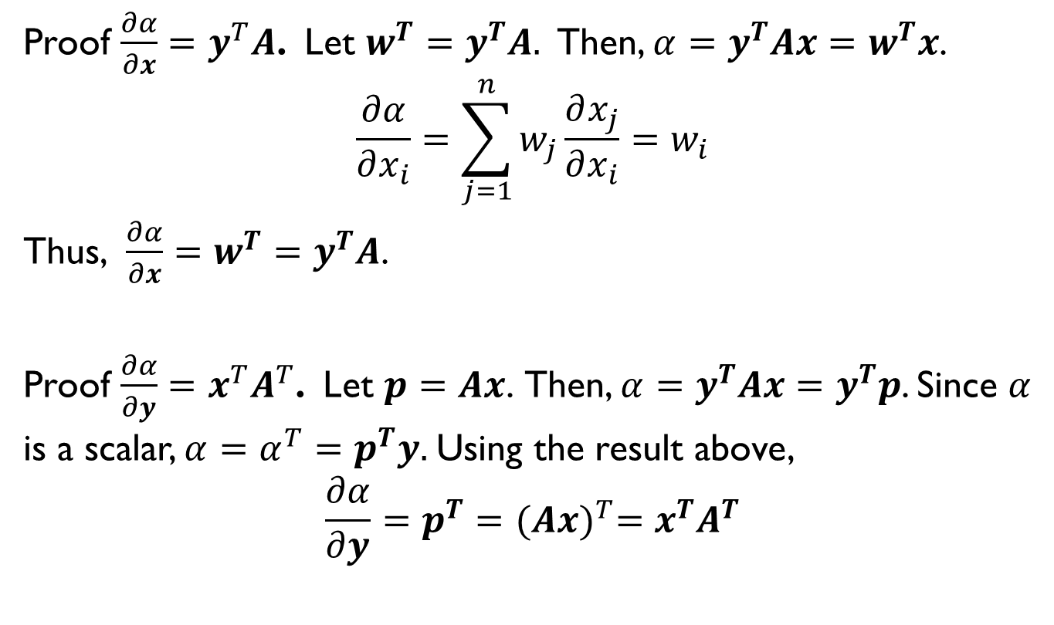
Some matrix differentiation formulas
Proof $\frac{∂α}{∂x}=y^{T}A$. Let ${w^{T}=y}^{T}A.$ Then, ${α=y^{T}Ax=w}^{T}x$.
$$\frac{∂α}{∂x_{i}}=\sum_{j=1}^{n}{w_{j}\frac{∂x_{j}}{∂x_{i}}}=w_{i}$$
Thus, $\frac{∂α}{∂x}={w^{T}=y}^{T}A$.
Proof $\frac{∂α}{∂y}=x^{T}A^{T}$. Let $p=Ax$. Then, ${α=y^{T}Ax=y}^{T}p$. Since $α$ is a scalar, $α=α^{T}=$ $p^{T}y.$Using the result above,
$$\frac{∂α}{∂y}=p^{T}={(Ax)}^{T}=x^{T}A^{T}$$

Slide 44
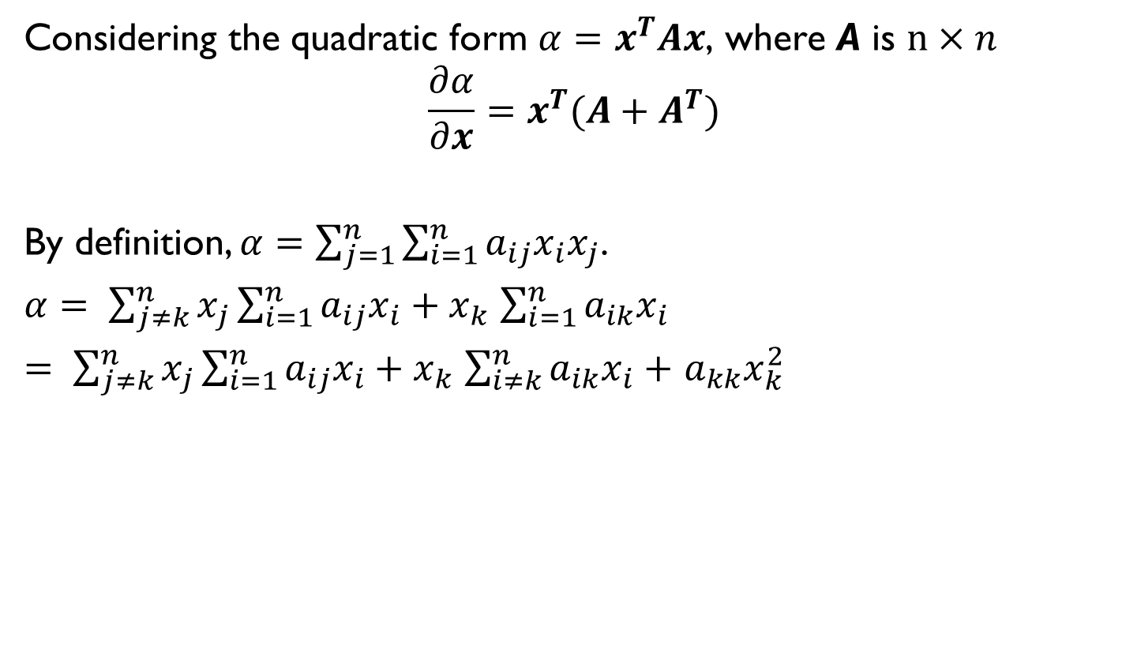
Some matrix differentiation formulas
Considering the quadratic form $α=x^{T}Ax$, where A is $n×n$
$$\frac{∂α}{∂x}=x^{T}(A+A^{T})$$
By definition, $α=\sum_{j=1}^{n}{\sum_{i=1}^{n}{a_{ij}x_{i}x_{j}}}$.
$α= \sum_{j≠k}^{n}{x_{j}\sum_{i=1}^{n}{a_{ij}x_{i}}}+x_{k}$ $\sum_{i=1}^{n}{a_{ik}x_{i}}$
$= \sum_{j≠k}^{n}{x_{j}\sum_{i=1}^{n}{a_{ij}x_{i}}}+x_{k}$ $\sum_{i≠k}^{n}{a_{ik}x_{i}+}$ $a_{kk}x_{k}^{2}$

Slide 45

Some matrix differentiation formulas
$\frac{∂α}{∂x_{k}}=$ $\sum_{j≠k}^{n}{x_{j}\sum_{i=1}^{n}{a_{ij}\frac{∂x_{i}}{∂x_{k}}}}$ $+ \frac{∂x_{k}}{∂x_{k}}\left(\sum_{i≠k}^{n}{a_{ik}x_{i}}\right)$ $+$ ${2a}_{kk}x_{k}^{}$
= $\sum_{j≠k}^{n}{{a_{kj}x}_{j}}$+ $\sum_{i≠k}^{n}{a_{ik}x_{i}}$+ ${2a}_{kk}x_{k}^{}$
= $\sum_{j=1}^{n}{{a_{kj}x}_{j}}$+ $\sum_{i=1}^{n}{a_{ik}x_{i}}$
Thus $\frac{∂α}{∂x}=x^{T}(A+A^{T})$

Slide 46

Some matrix differentiation formulas
If A is a symmetric matrix and $α=x^{T}Ax,$where $x$ is $n×1$, A is $n×n$ and A is not dependent on $x, then$
$$\frac{∂α}{∂x}={2x}^{T}A$$
Using the result, $\frac{∂α}{∂x}=x^{T}\left(A+A^{T}\right)$, the proof is straight forward.

Slide 47
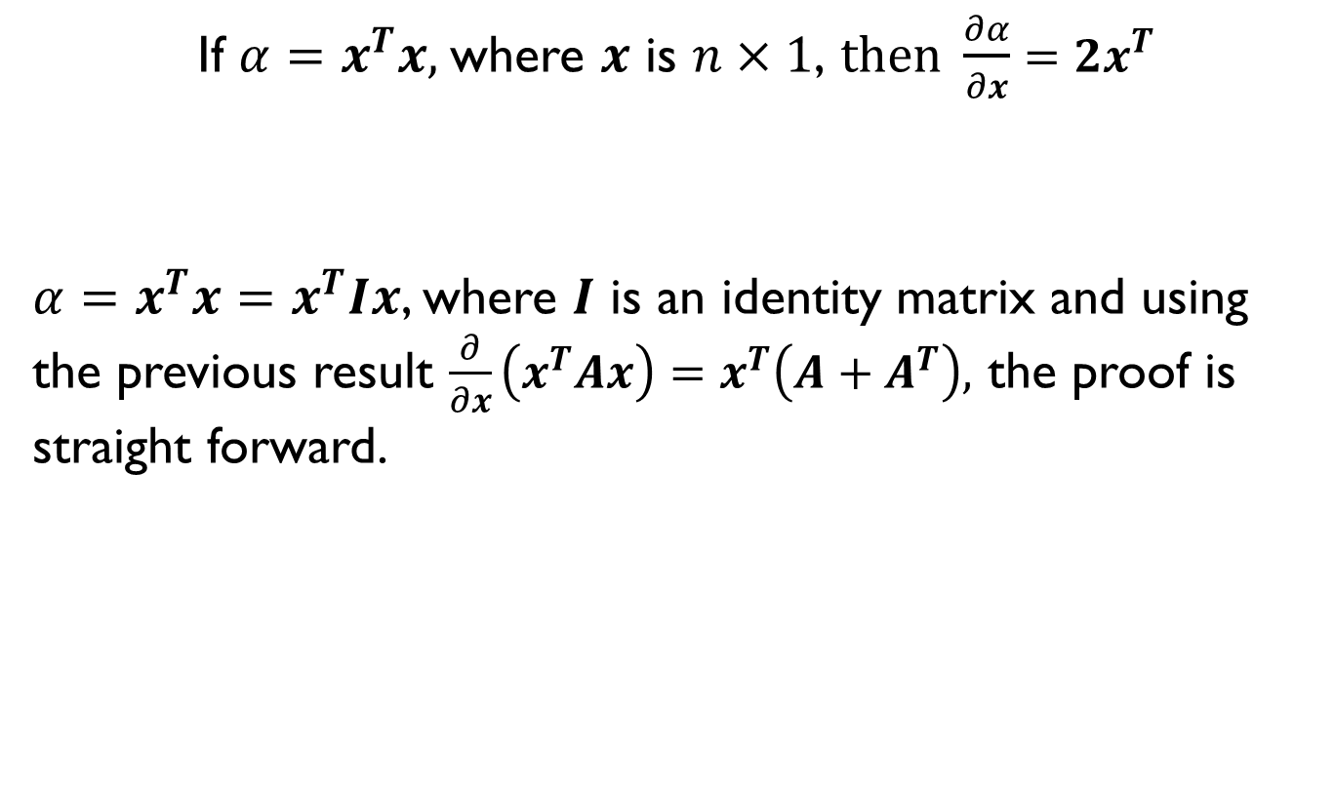
Some matrix differentiation formulas
If $α=x^{T}x,$where $x$ is $n×1$, $then \frac{∂α}{∂x}={2x}^{T}$
$α=x^{T}x=x^{T}Ix$, where $I$ is an identity matrix and using the previous result $\frac{∂}{∂x}\left(x^{T}Ax\right)=x^{T}\left(A+A^{T}\right),$ the proof is straight forward.

Slide 48

Some matrix differentiation formulas
Let $α=y^{T}x,$ where $y$ is $n×1, x$ is $n×1$ and both $y$and $x$ are functions of the vector $z$. Then,
$$\frac{∂α}{∂z}=x^{T}\frac{∂y}{∂z}+y^{T}\frac{∂x}{∂z}$$
Proof: $α=\sum_{j=1}^{n}{x_{j}y_{j}.}$ $\frac{∂α}{∂z_{k}}=\sum_{j=1}^{n}{x_{j}\frac{∂y_{j}}{∂z_{k}}+}$ $y_{j}\frac{∂x_{j}}{∂z_{k}}$
Thus, ${\frac{∂α}{∂z}=x}^{T}\frac{∂y}{∂z}+y^{T}\frac{∂x}{∂z}$

Slide 49

Some matrix differentiation formulas
Let $α=x^{T}x,$ where $x$ is $n×1$and $x$ is a function of the vector $z$. Then,
$$\frac{∂α}{∂z}={2x}^{T}\frac{∂x}{∂z}$$
Using the results in the previous slide, the proof is straight forward.

Slide 50

Some matrix differentiation formulas
Let $α=y^{T}Ax,$ where $y$ is $m×1, x$ is $n×1$ and $A$is $m×n.$Both $y$and $x$ are functions of the vector $z$ but $A$ is independent of $z.$ Then,
$$\frac{∂α}{∂z}=x^{T}A^{T}\frac{∂y}{∂z}+y^{T}A\frac{∂x}{∂z}$$

Slide 51

Some matrix differentiation formulas
Proof: Let $w^{T}=y^{T}A$. $α=w^{T}x$. Using the results in slide 48, we have
$\frac{∂α}{∂z}=x^{T}\frac{∂w}{∂z}+w^{T}\frac{∂x}{∂z}$.
Substituting $w^{T}=y^{T}A$ in it, we have
$$\frac{∂α}{∂z}=x^{T}\frac{∂A^{T}y}{∂z}+y^{T}A\frac{∂x}{∂z}$$
= $x^{T}A^{T}\frac{∂y}{∂z}+y^{T}A\frac{∂x}{∂z}$

Slide 52

Some matrix differentiation formulas
Let $α=x^{T}Ax,$ where $x$ is $n×1,$ $A$is $n ×n$and $x$ is a function of the vector $z$ but $A$ is independent of $z.$ Then,
$$\frac{∂α}{∂z}=x^{T}(A^{T}+A)\frac{∂x}{∂z}$$
Using the result in the slide 50, it can be proven easily.

Slide 53

Some matrix differentiation formulas
Let $α=x^{T}Ax,$ where $x$ is $n×1,$ $A$is a $n ×n$symmetric matrix and $x$ is a function of the vector $z$ but $A$ is independent of $z.$ Then,
$$\frac{∂α}{∂z}=2x^{T}A\frac{∂x}{∂z}$$
Using the result in the slide 52, it can be proven easily.

Slide 54
More formulas
K. B. Peteren and M. S. Pedersen, The Matrix Codebook
https://www.math.uwaterloo.ca/~hwolkowi/matrixcookbook.pdf

